Slide 1


Good afternoon and welcome to the Reception phonics workshop.

Slide 2


Slide 3
Teach a child to read
and keep that child reading [and talking]
and we will change everything.
And I mean everything.
Jeanette Winterson

Slide 4


Slide 5






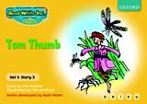


Slide 6
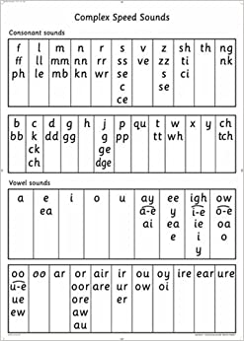
26 letters of the alphabet
These letters and combinations of these letters make 44 sounds.

Slide 7
Phoneme – Sound
Grapheme – A written symbol that represent a sound.
Decode – Seeing a symbol and saying the sound
Encoding – Hearing a sound and writing the symbol.

Slide 8
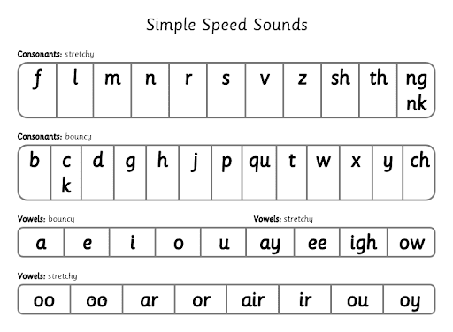

Slide 9


Slide 10
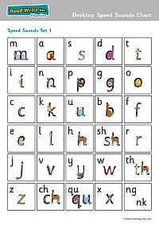
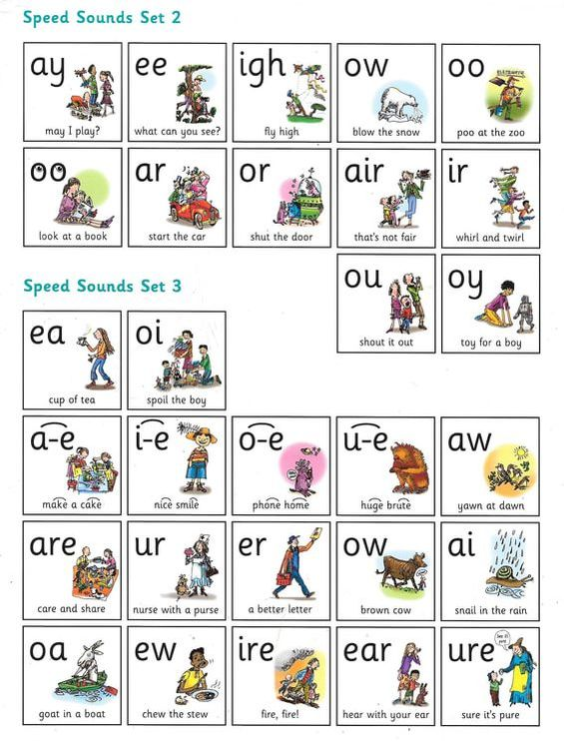

Slide 11
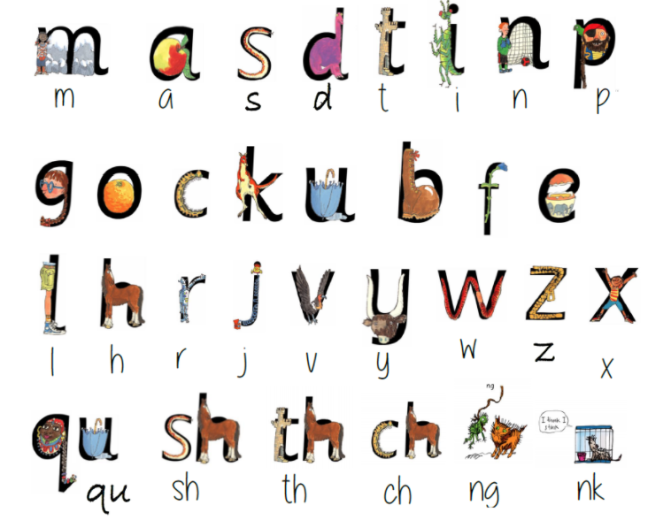

Slide 12
Our Phonics lessons…
-Teach sounds
-Blending
-Formation
-Spelling

Slide 13
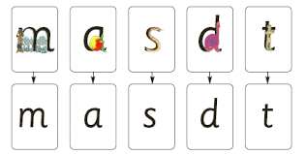
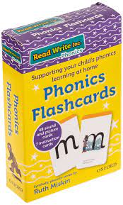
Sounds – pure sounds not the letters

Slide 14
Blending – is the skill that helps us read, especially when confronted with unfamiliar words. It involves pushing together the sounds of the letters in the word to create the whole word.
Play games where you can sound out and your child can blend them together to guess your word.
c – a – t
m – a – t
s – a – t

Slide 15
Helping your child decode unfamiliar words
Say each sound in the word
Say the word
If they pronounce the word incorrectly or get letters mixed up, sound it out and say it again.

Slide 16
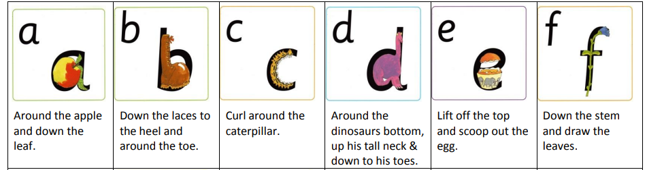
Letter formation

Slide 17
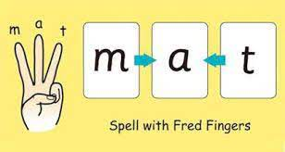
Spelling

Slide 18
Red words
These are words we can not sound out. Children will need to stop and think about these when reading and spelling them.
I of my to
the put me no

Slide 19
Home reading
Please make sign your child’s planner to say they have read/practised their sounds every evening. This just needs to be for 5/10minutes every day.
Sounds sheet
Sound sheets – these are to practise the formation of the sounds we have been doing in class.
Library book
Library books are there for you to read as a family. Read through it, discuss what is happening, engage your child in a story.

Slide 20

Support at home
Coats
Identifying name
Clear instructions
Correcting children when speaking

