Slide 1
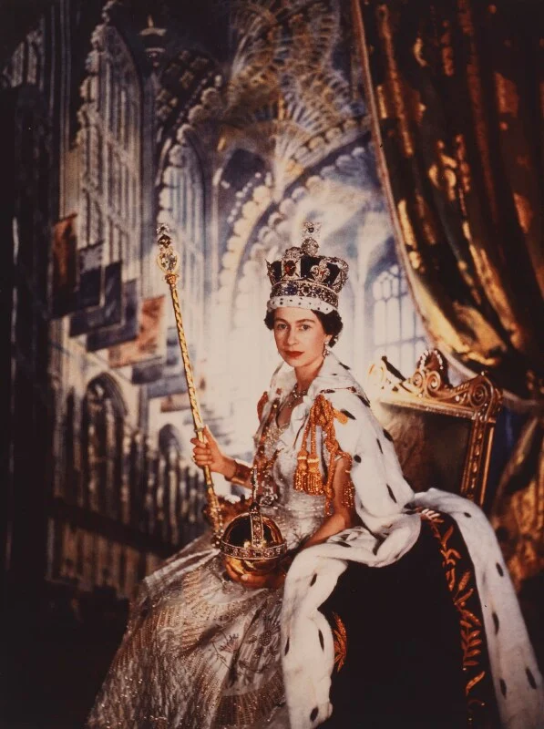

We give thanks for the life of HRH
Queen Elizabeth II
Following in the footsteps of Jesus we love, live and learn together.

Slide 2
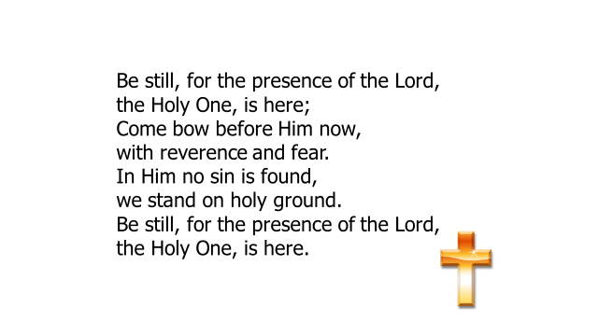

Slide 3

Be still, for the glory of the Lord
is shining all around;
He burns with holy fire,
with splendour he is crowned.
How awesome is the sight,
our radiant king of light!
Be still, for the glory of the Lord
is shining all around.

Slide 4
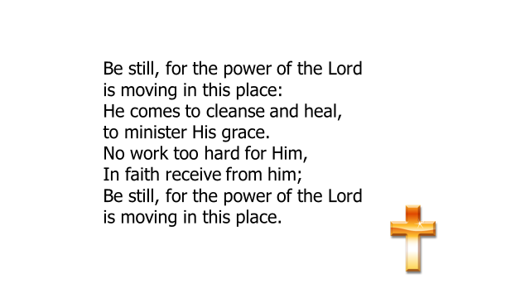

Slide 5
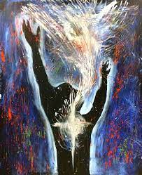
A reading from the book of Peter
Above all, love each other deeply, because love covers over a multitude of sins.
Offer hospitality to one another without grumbling. Each of you should use whatever gift you have received to serve others, as faithful stewards of God’s grace in its various forms.
If anyone speaks, they should do so as one who speaks the very words of God. If anyone serves, they should do so with the strength God provides, so that in all things God may be praised through Jesus Christ.
To him be the glory and the power for ever and ever.
Amen.
The Word of the Lord
Thanks be to God

Slide 6
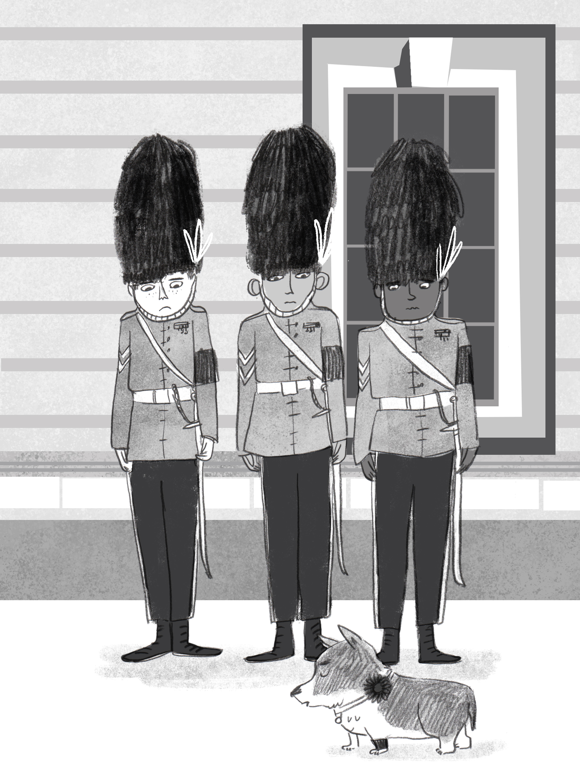
Dear God
We gather here today to remember Her Majesty the Queen.
We give thanks for her long life, and for all the ways she loved and served those in her care.
We bring you our sadness for what we have lost;
Our gratitude for what we remember and cherish;
And our wondering about what is to yet to come.
Thank you for the comfort, peace and hope you bring us.
Amen

Slide 7
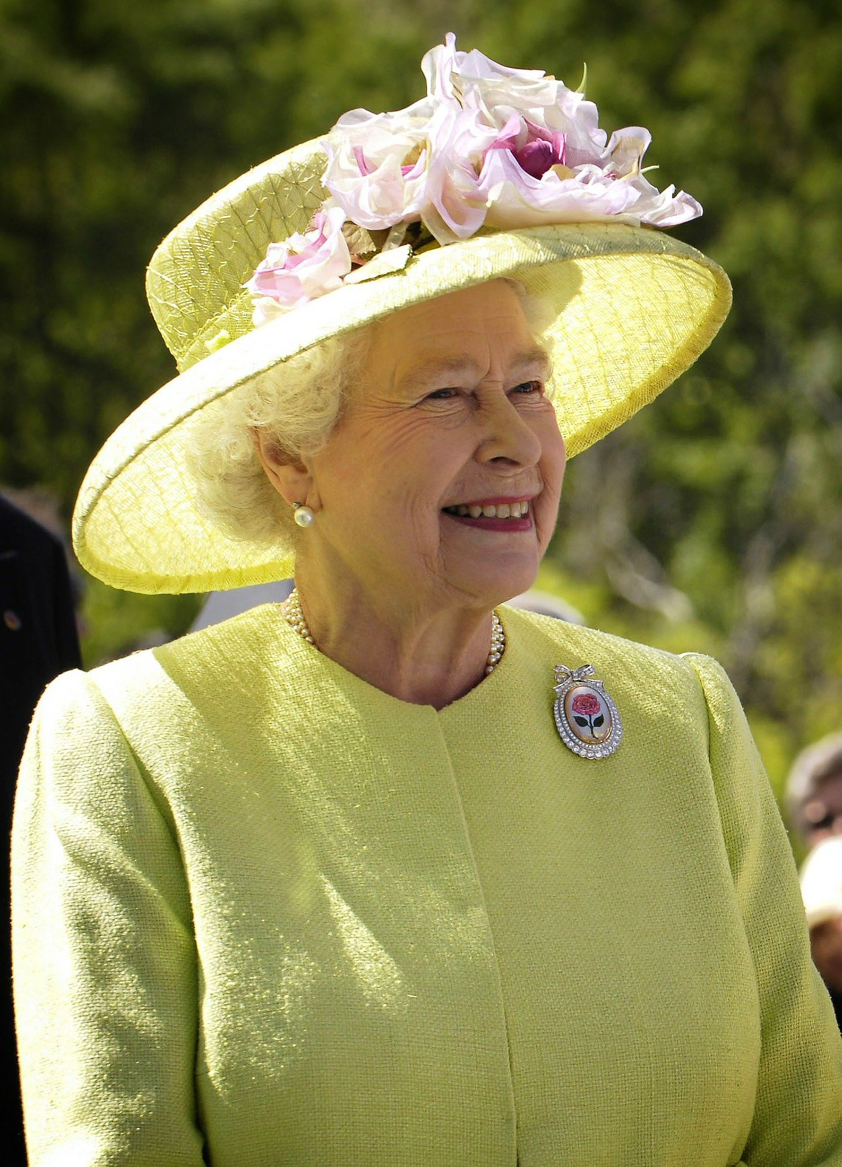
Who was the Queen to you?

Slide 8
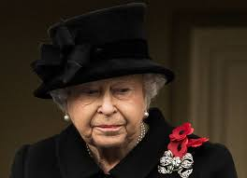
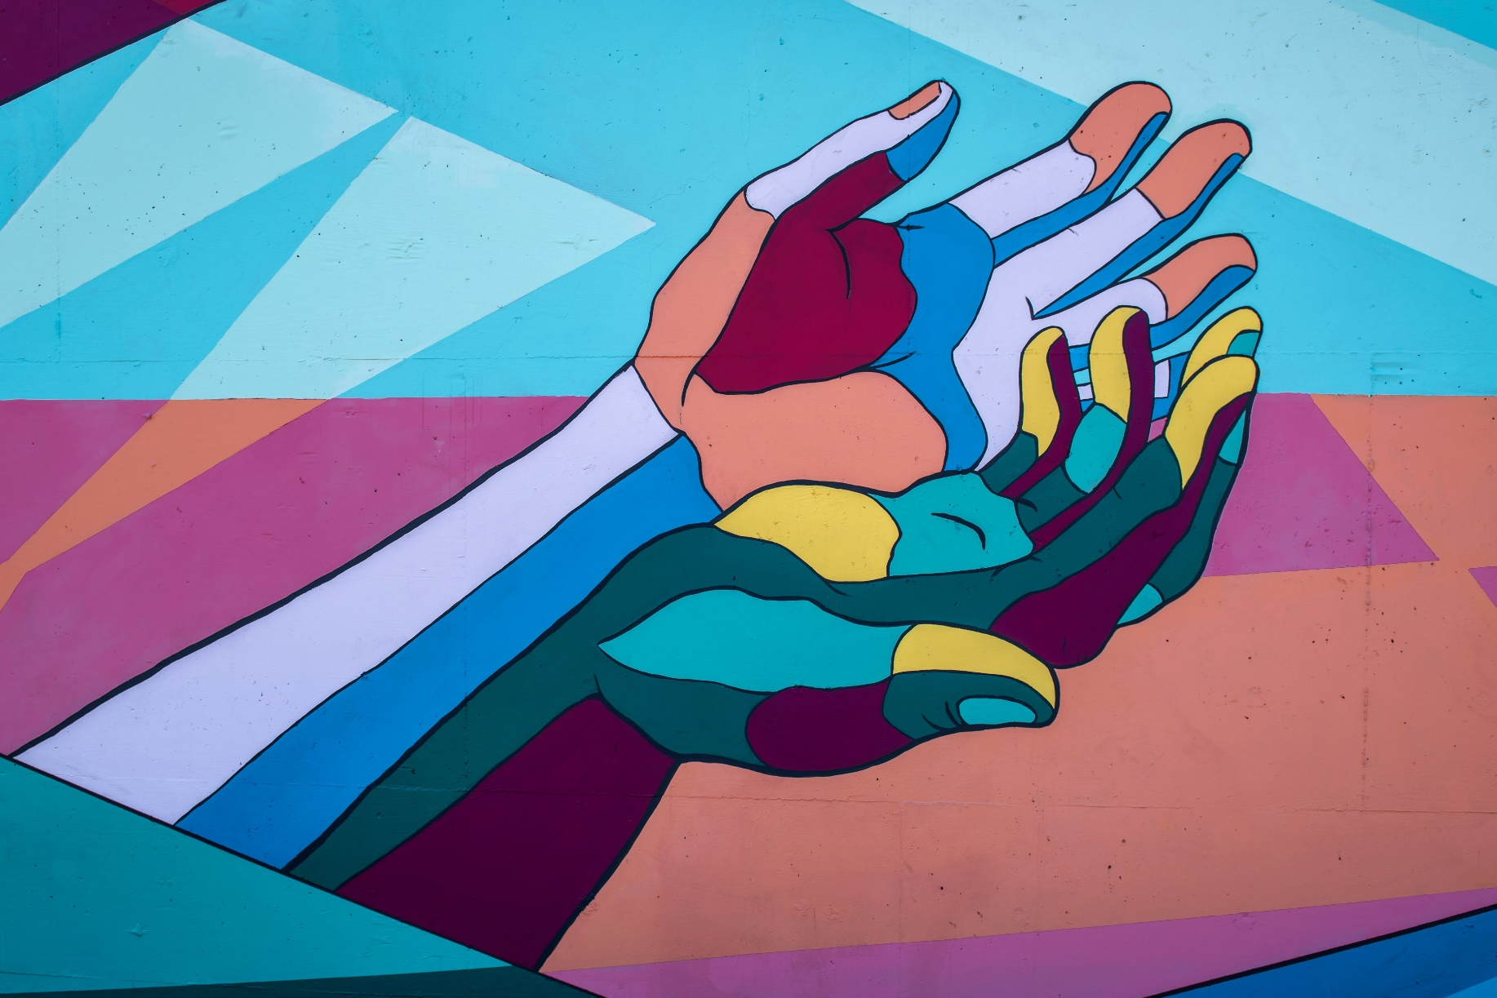
I wonder… is it always easy to serve and think of others?
I wonder… what can we learn from the Queen’s example in asking for God’s help?
I declare before you all that my whole life, whether it be long or short, shall be devoted to your service ... God help me to make good my vow, and God bless all of you who are willing to share in it.

Slide 9
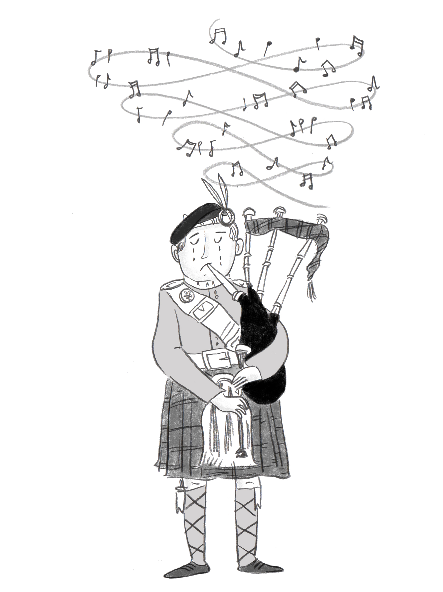
HM Queen Elizabeth II
Today I am feeling………………………… about the Queen
I remember the Queen ………………………………………
The Queen showed us how to be……………………………
I hope we never forget………………………………………

Slide 10

“The love will have been enough; all those impulses of love return to the love that made them. Even memory is not necessary for love.”
Above all, love each other deeply.
1 Peter 4:8

Slide 11
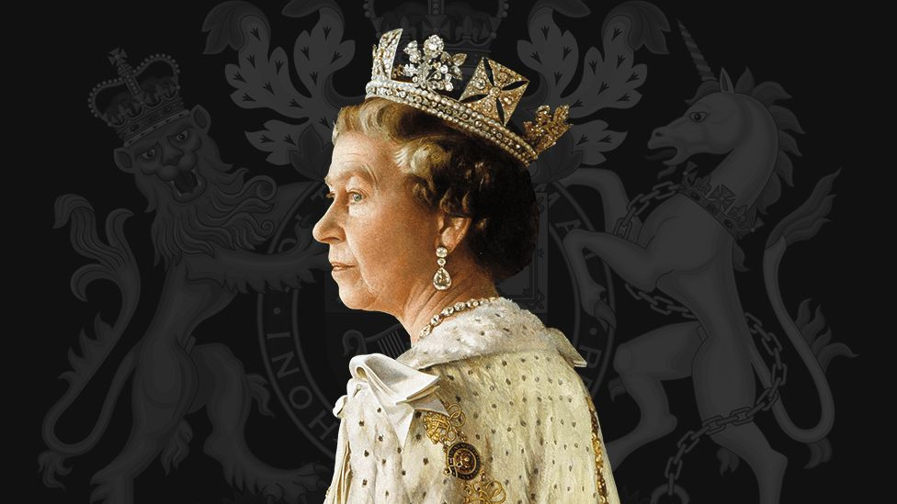
We pray for the repose of the soul of Her Majesty Queen Elizabeth II. We give thanks for her life of faith and service to God and to the people of this country, the Realms and the Commonwealth.
Lord in your mercy
R: Hear our prayer.

Slide 12
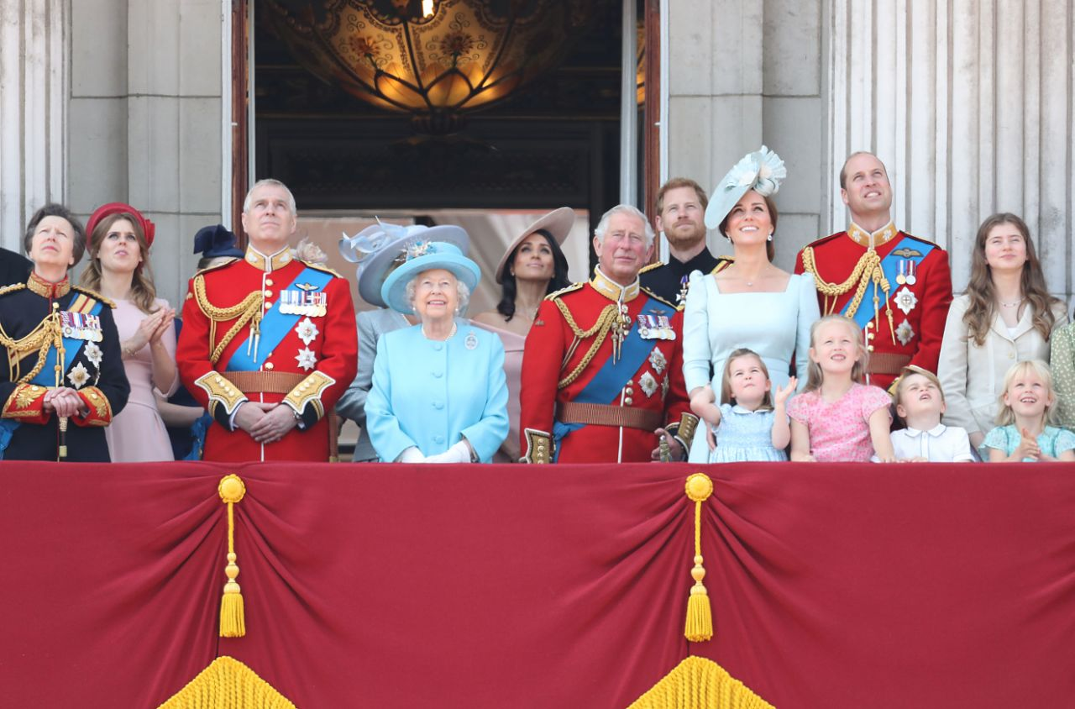
We remember all those who in mourn for Her Majesty and especially her family. May they be comforted by the love of the Our Lord Jesus Christ.
Lord hear us
R: Hear our prayer.

Slide 13
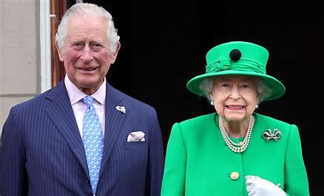
We pray for His Majesty the King Charles III. We ask that God blesses him and gives him the strength as he begins his reign.
Lord hear us
R: Hear our prayer.

Slide 14
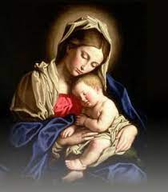
We turn to Mary who is both our Mother and Queen of Heaven and ask her to intercede for us as we continue to pray for Her Majesty.
Hail Mary…

Slide 15
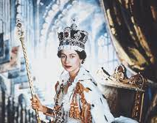
Eternal rest grant unto her,
O Lord,
and let perpetual light shine
upon her.
May she rest in peace. Amen.

Slide 16
Now let your servant depart in peace.
Luke 2:29

