Slide 1

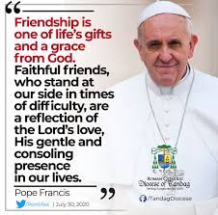

Anti Bullying Week 2022
REACH OUT!

Slide 2

Gather, gather,
Gather in the light of his flame.
And we’ll gather, gather,
Shout, praise, glorify his name.
Gather with our families. (Echo)
Gather with our friends. (Echo)
Proclaim. (Echo)
Gather, gather,
Gather in the light of his flame.
And we’ll gather, gather,
Shout, praise, glorify his name.
Gather

Slide 3
Lord,
We give thanks for the friendships in our lives. May you help us to always be kind and caring, to show respect to every body around us. Help us to remember that we are better together.
Amen.
Gather

Slide 4
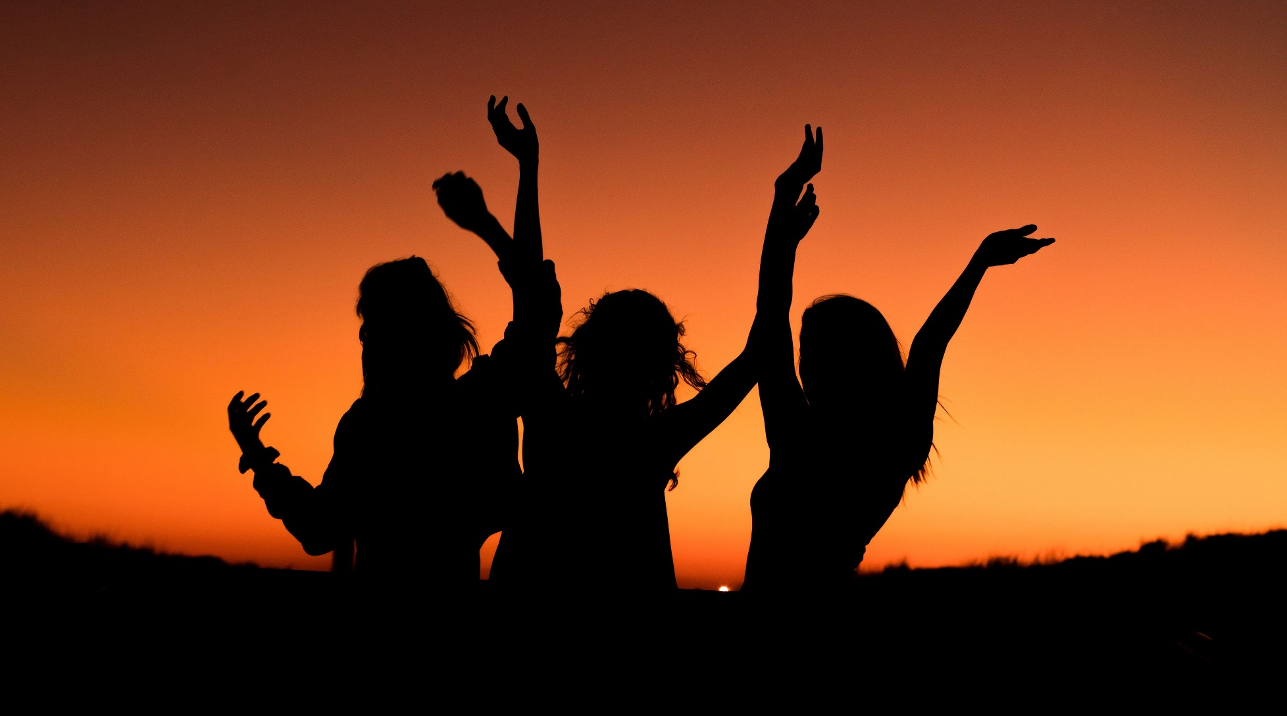
Gather

Slide 5
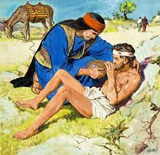

The Good Samaritan
The Gospel of the Lord
Praise to you, Lord Jesus Christ
Listen

Slide 6


How did the Good Samaritan reach out by making a difference?
What can you do?

Slide 7
https://anti-bullyingalliance.org.uk/anti-bullying-week/school-resources/primary-school-pack

Slide 8
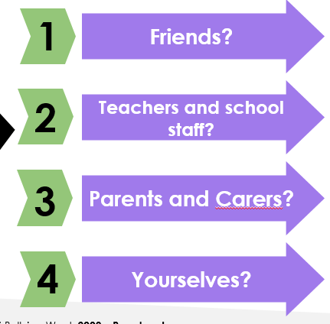
How could we reach out to…

Slide 9
Everybody deserves respect
Nobody should be made to feel alone
We are more powerful as a team.
We need to stand in solidarity together

Slide 10
Together we can be Change Makers!
How are YOU going to make the change?
Not just this week, but all of the time!

Slide 11

Every day this week we are looking for change makers. How are you going to make the change?

Slide 12


Your Mission
You mission this week is to encourage your friends to REACH OUT and STAND IN SOLIDARITY with each other.
We can all be change makers and follow in the footsteps of Jesus.

Slide 13
Where it began, I can't begin to knowing
But then I know it's growing strong
Was in the spring
And spring became the summer
Who'd have believed you'd come along
Hands, touching hands
Reaching out, touching me, touching you
Sweet Caroline
Good times never seemed so good
I've been inclined
To believe they never would
But now I

Slide 14
Look at the night and it don't seem so lonely
We filled it up with only two
And when I hurt
Hurting runs off my shoulders
How can I hurt when holding you
One, touching one
Reaching out, touching me, touching you
Sweet Caroline
Good times never seemed so good
I've been inclined
To believe they never would
Oh no, no
Sweet Caroline
Good times never seemed so good
Sweet Caroline
I believe they never could
Sweet Caroline
Good times never seemed so good

