Slide 1
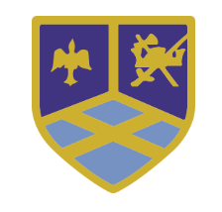

All Souls’ Day: May They Rest in Peace
November 2nd

Slide 2

Our Mission Statement
Following in the footsteps of Jesus, we love, live and learn together.
Gather
Gather

Slide 3
What is All Souls’ Day?
All Souls’ Day is a holiday in the Roman Catholic calendar that falls on November 2.
The Roman Catholic church sets aside All Souls’ Day to remember members of the faith who have died.
Through prayers, masses, and almsgiving, the living pay tribute to the dead who enter into heaven.
Heaven is the eternal state of perfect happiness where those who were faithful to God in this life enjoy the Beatific Vision: seeing God face-to-face.

Slide 4

Do not be afraid, for I have redeemed you,
I have called you by your name; you are mine.
1. When you walk through the waters I’ll be with you,
You will never sink beneath the waves.
2. When the fire is burning all around you,
You will never be consumed by the flames.
3. When the fear of loneliness is looming,
Then remember I am at your side.
4. When you dwell in the exile of the stranger,
Remember you are precious in my eyes.
5. You are mine, O my child, I am your Father,
And I love you with a perfect love.

Slide 5
Do not be afraid, for I have redeemed you,
I have called you by your name; you are mine.
4. When you dwell in the exile of the stranger,
Remember you are precious in my eyes.
5. You are mine, O my child, I am your Father,
And I love you with a perfect love.

Slide 6
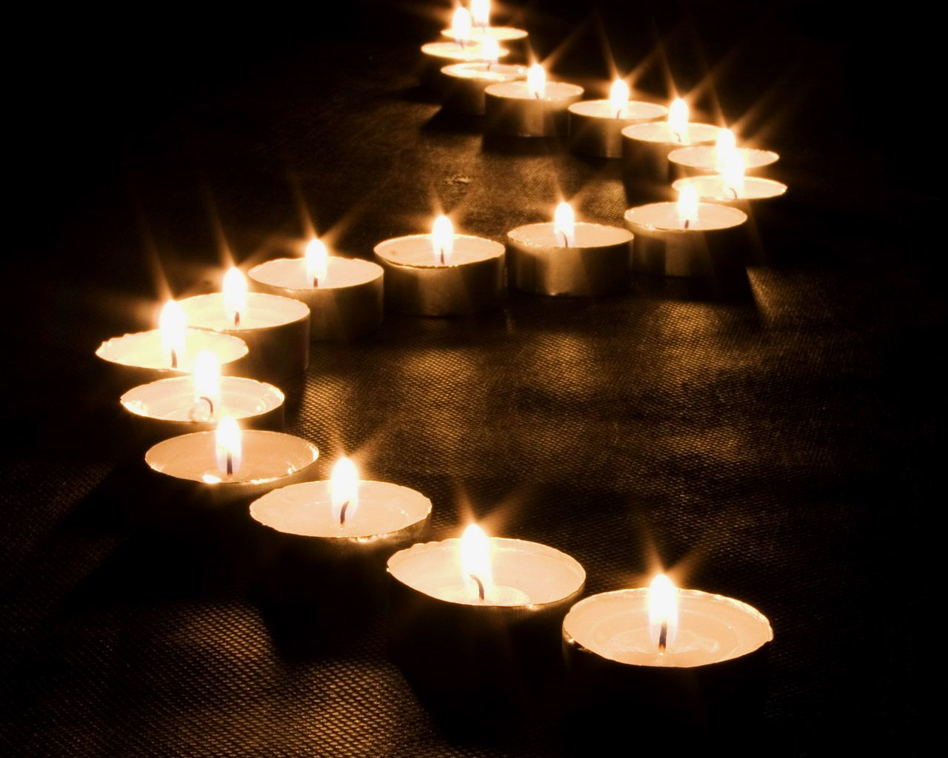

Slide 7
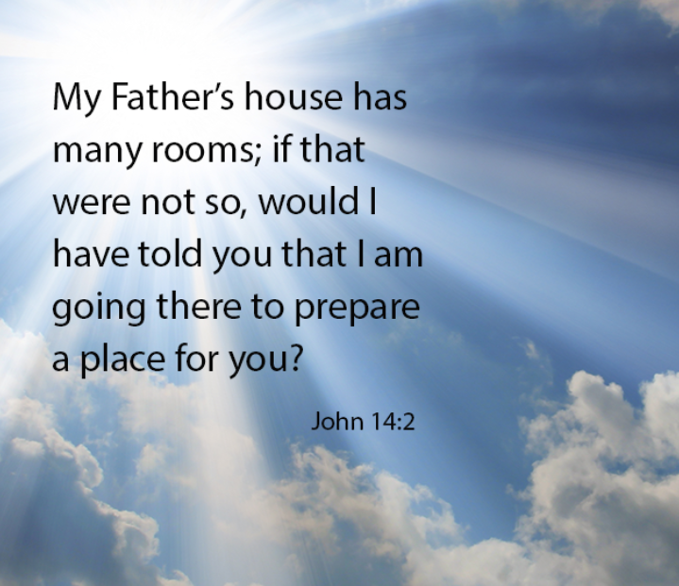

A reading from the Holy Gospel according to John 14:2
The Gospel of the Lord
Praise to you, Lord Jesus Christ
Listen

Slide 8
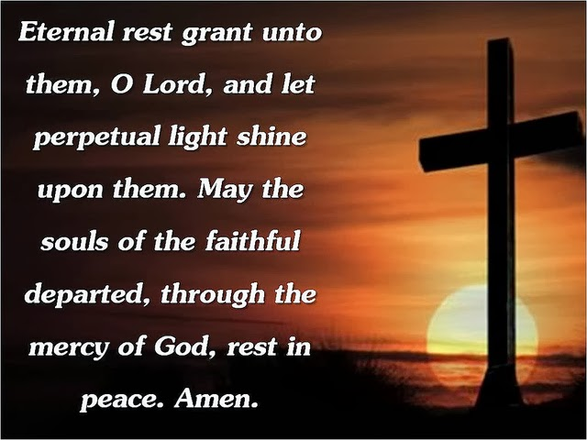

Who would you like to pray for and remember?
Respond

Slide 9

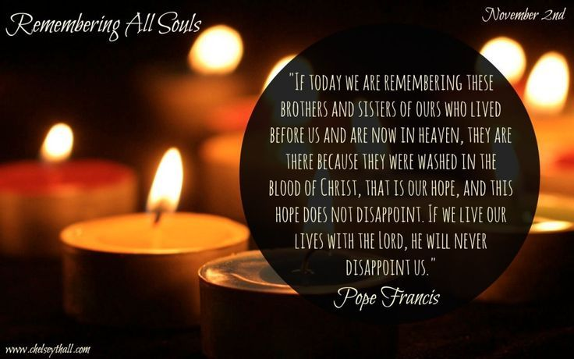
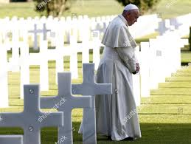

Your Mission
Go Forth

Slide 10
Jesus, remember me when you come into your kingdom
Jesus, remember me when you come into your kingdom x4

Slide 11
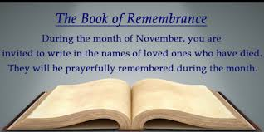
Remembrance

