Slide 1



KiVa – Anti-Bullying and Behaviour Programme

Slide 2
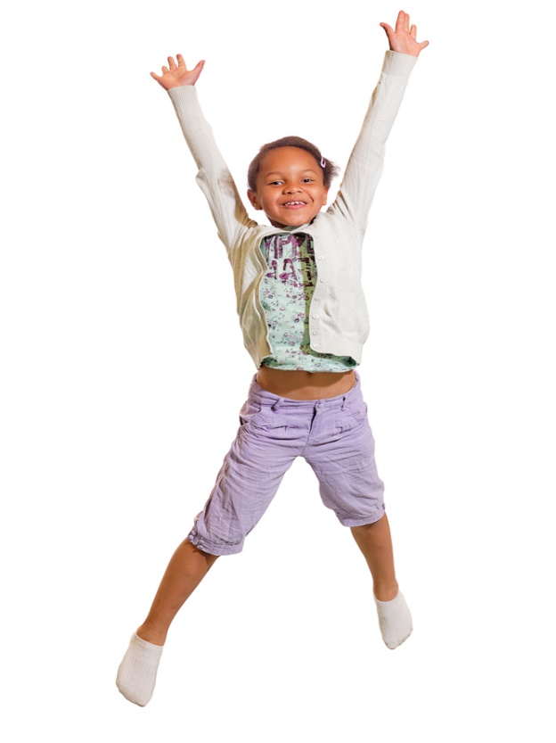
Discussion points:
KiVa antibullying programme and bullying and how St Alban’s will weave the Gospel Virtues and Catholic Social Teaching into it.
Universal actions
Indicated actions
Implementation of the KiVa antibullying programme
Behaviour at St Alban’s – Our approach

Slide 3
KiVa Anti-Bullying programme
Evidence-based programme to prevent and reduce bullying
Developed at the University of Turku, Finland (funded by the Finnish Ministry of Education and Culture)
Broadly used in Finland and in other countries (www.kivaprogram.net)
KiVa antibullying programme ® and bullying
Notes:
Extra handouts available with the pilot research information for anyone interested.

Slide 4
Goals:
To prevent new bullying cases from emerging
To tackle bullying cases effectively
To minimise negative effects caused by bullying
To express their own understanding that they are valued and cared for as unique persons, made in the image and likeness of God. They are happy, confident and feel secure.
All of these goals will be woven into the fabric of our Catholic Values and Mission.
KiVa antibullying ® and bullying
Notes:
This training will provide you with information about bullying and how to tackle it.

Slide 5
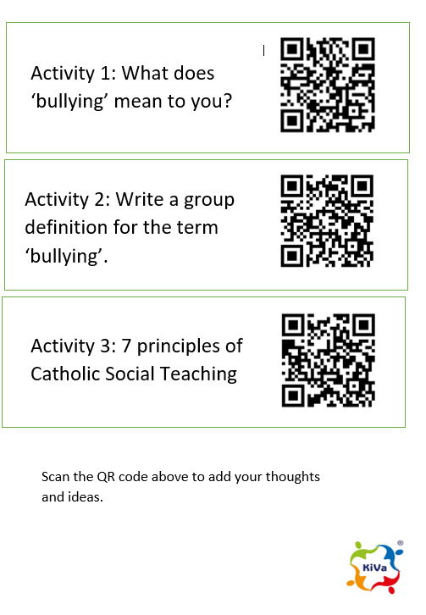
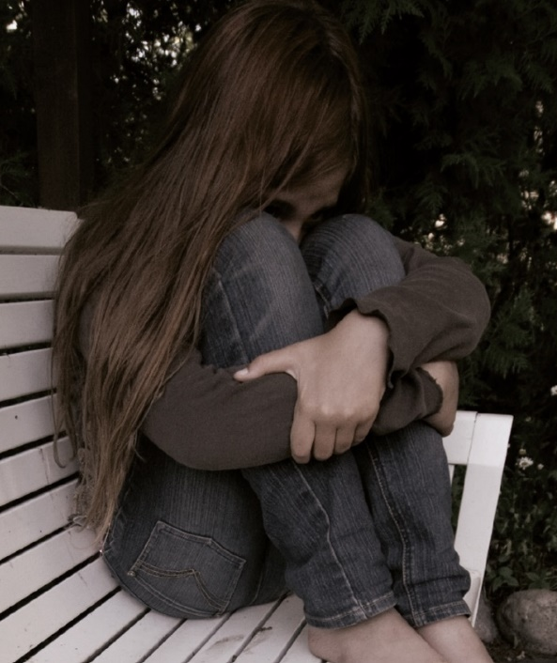
What is Bullying?
Activity 1 & 2:
1. What does ‘bullying’ mean to you?
2. Write a group definition for the term ‘bullying.’
PADLET ACTIVITY
KiVa antibullying programme® and bullying

Slide 6
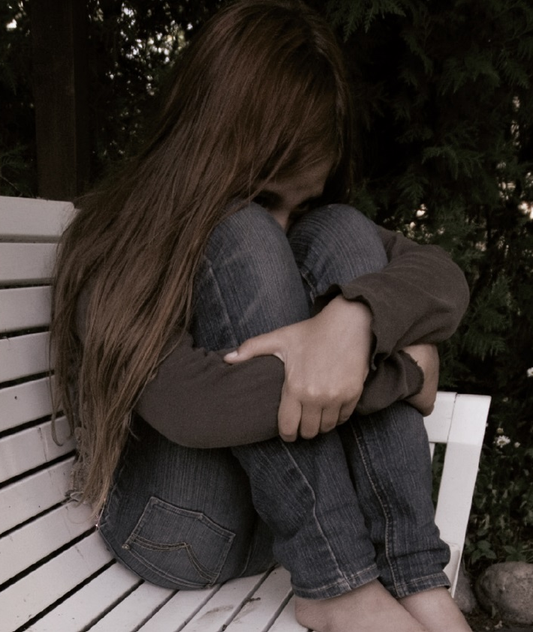
What is bullying?
Harmful behaviour/degrading treatment which is;
  repeated
  targeted at a relatively defenseless or a less powerful person
KiVa antibullying programme® and bullying
Notes:
Why do we need to define bullying? See page 6 in the Teacher’s manual.

Slide 7
What is not bullying?
Bullying is not...
  a conflict,
  an argument, or
  a fight.
  Instead it is a manifestation of a repressive relationship; an abuse of power and strength.
KiVa antibullying programme® and bullying

Slide 8
Forms of bullying
Most often bullying is verbal (name-calling, public ridicule).
Indirect bullying (exluding a person from group, spreading mean stories about him/her) is also quite common.
Physical bullying (pushing, hitting, kicking) is not that common.
KiVa antibullying programme® and bullying

Slide 9
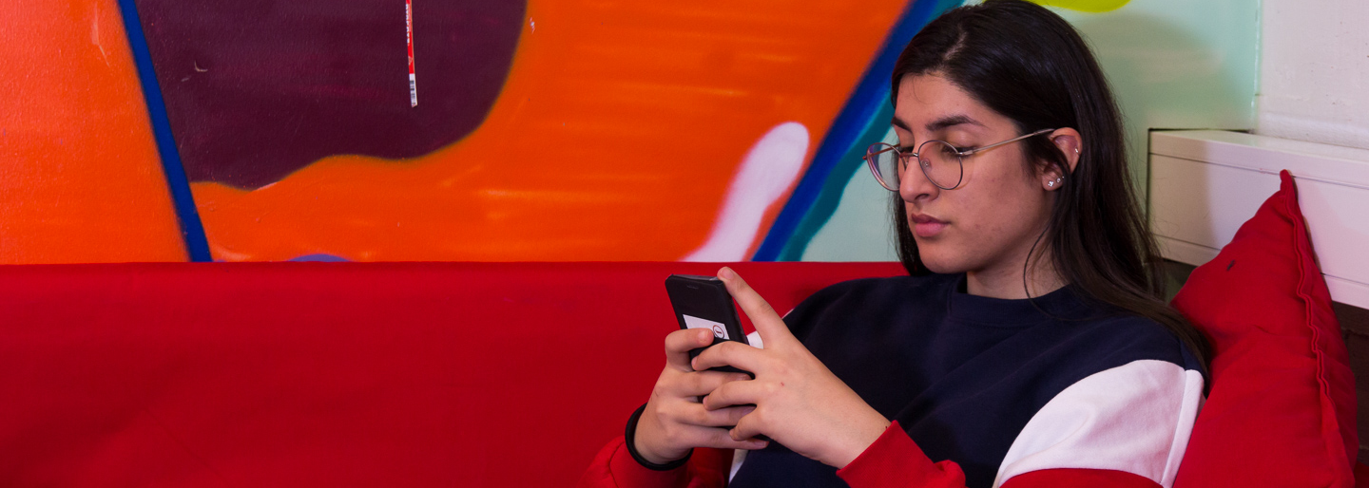
Cyberbullying has increased, although the prevalence of it is still relatively low (in comparison with other forms). Targets of cyberbullying are almost always bullied in other ways.
KiVa antibullying programme® and bullying

Slide 10
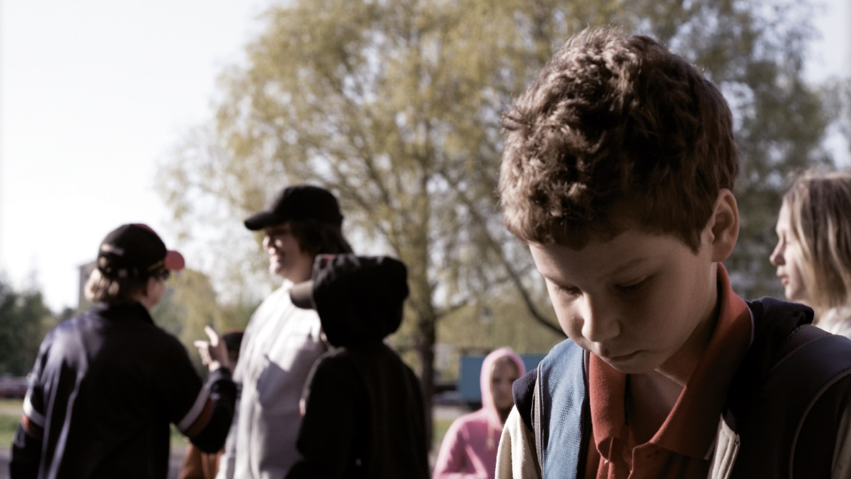
In defining bullying the focus is not on the form of bullying, but rather if the actions are deliberate and systematic.
A bullied child or adolescent is usually bullied in many ways.
KiVa antibullying programme® and bullying

Slide 11
Ofcom research (2022) and Office for National Statistics (ONS)
Older children in the UK are more likely to be bullied on a screen than in person, Ofcom has found.
Their latest study into children’s media and online habits shows that four in 10 children aged 8-17 (39%) have experienced bullying, either on or offline. Among these children, the bullying was more likely to happen on a device (84%) than face-to-face (61%).
Nearly three out of four children (72%) who had experienced an online bullying behaviour experienced at least some of it at school or during school time.
More than half (52%) of those children who experienced online bullying behaviours1 said they would not describe these behaviours as bullying, and one in four (26%) did not report their experiences to anyone.
KiVa Finland have not yet finished preparing the survey results for our pupils.
KiVa antibullying programme® and bullying

Slide 12
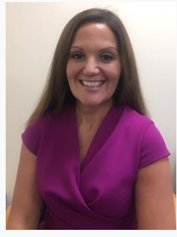
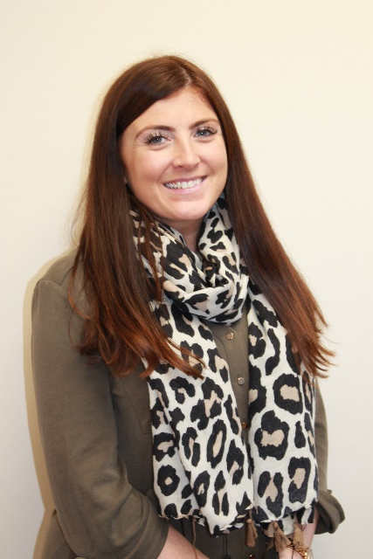
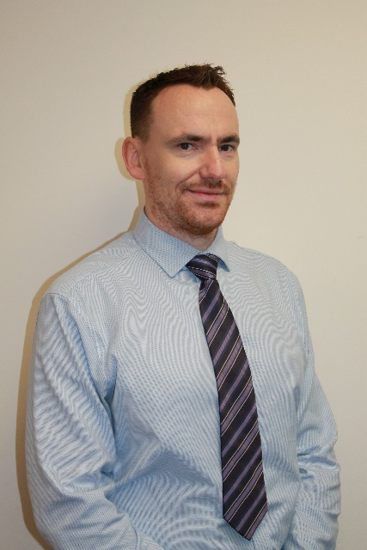
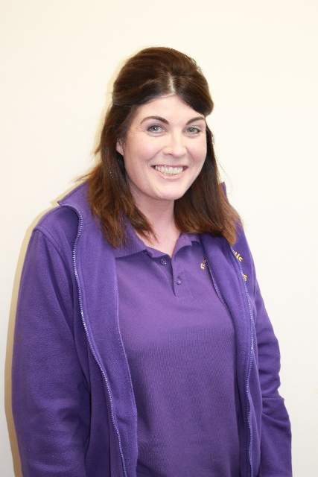
KiVa Team
Mrs Donnellan
Mr Griffin
Mrs McKinney
Mrs Doherty

Slide 13
KiVa antibullying programme
Universal actions
Indicated actions
  Coordination of the programme
  KiVa lessons and themes
  Communication with parents
  Student and staff survey
  Posters, vests for monitors
  Tackling acute cases of bullying
  The KiVa team in school + cooperation with the classroom teacher
KiVa antibullying programme® and bullying

Slide 14
Universal actions
For all pupils and parents

Slide 15
Bullying does not concern only the bullies and the bullied students
Most children do not accept bullying
Many however end up following the bully, or keeping quiet.
Only a few support the bullied student.
Universal actions - Coordination

Slide 16
Bullying-related group norms often dictate that being friends with the bullied student is not allowed; you’re not supposed to accept him/her.
The bullied student’s status in the group continues to worsen over time.
Universal actions - Coordination

Slide 17
It’s important that all the students understand that they can make a difference!
  ”Let’s stop bullying together!”
  This is the goal of the Universal actions in KiVa antibullying programme.
Universal actions - Coordination

Slide 18
Goals for the lessons and themes:
  Getting the children to understand the role a group plays in bullying.
  Increasing empathy for the bullied students.
  Learning ways to support the bullied student, and taking responsibility for not allowing bullying to occur in the group.
Universal actions – Lessons and themes

Slide 19
KiVa lessons and themes form a continuum during the basic education
Lesson plans (Teacher’s manual)
KiVa games
Universal actions – Lessons and themes

Slide 20
KiVa lessons and themes form a continuum during the basic education
KS2
  Lessons for Year 3 to 4: 10 double lessons (90 mins)
  Lessons for Year 5 to 6: 10 double lessons (90 mins)
  One double lesson every month. The first lesson will start on Friday 9th September. Other dates will be updated on the school calendar.
Universal actions – Lessons and themes
Notes:
Enhances existing curriculum.

Slide 21
Indicated actions
When bullying cases emerge

Slide 22
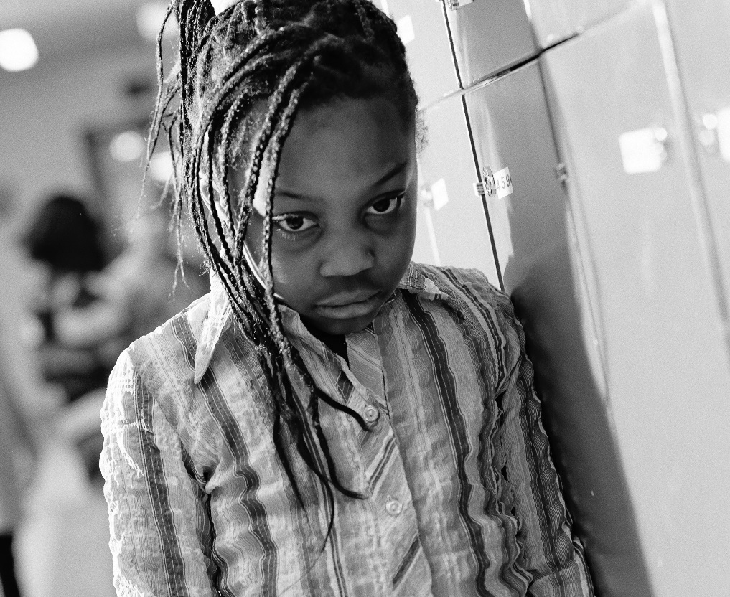
Tackling bullying
The KiVa team
Screening of bullying
Discussions
Cooperation with the parents
Indicated actions – Tackling bullying

Slide 23
1. KiVa team
When suspected bullying case comes to attention, the KiVa team tackles the case in cooperation with the class teacher.
Indicated actions – Tackling bullying

Slide 24
Two different methods for tackling bullying
Confronting method C
Non-confronting method NC (recommended especially when there is no clear evidence of bullying)
KiVa team members are familiar with the methods.
Indicated actions – Tackling bullying

Slide 25
2. Screening: is this bullying?
When the suspected bullying case comes to attention, the adult who is present or is first informed of the incident;
  gathers the needed background information and completes Action Form 1, and
  directs the case to the KiVa team, if it is a bullying case.
Indicated actions – Tackling bullying
Notes:
(see Part III at the end of the Teacher’s manual)

Slide 26
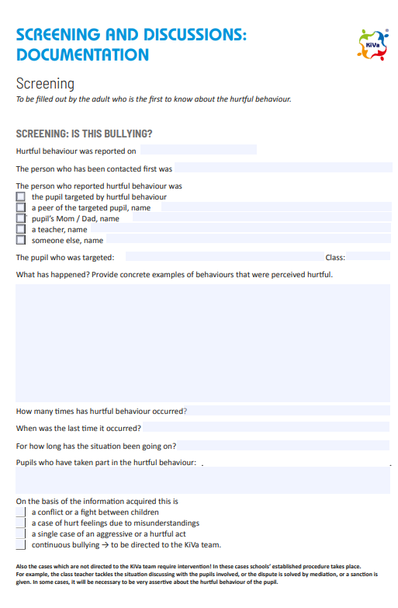
Action Form 1
  Screening Forms will be located around the school and easily accessible.
  All forms need to be scanned and uploaded onto Cpoms.
  Paper copies will be kept in a folder in HT office. Lunch time staff to give paper copies to CD who will screen, scan and upload onto Cpoms. (Mon-Rmc/LD/AG)
  Action Forms 2-6 to only be used by the KiVa team when an incident has been confirmed as bullying.

Slide 27
3. Discussions
The KiVa team: discussions with the bullied student and the bully/bullies.
Class teacher: a discussion with a few classmates who are prosocial and have good status: ”Your help is needed.”
Follow-up discussion with the bullied student and bully/bullies.
Indicated actions – Tackling bullying

Slide 28
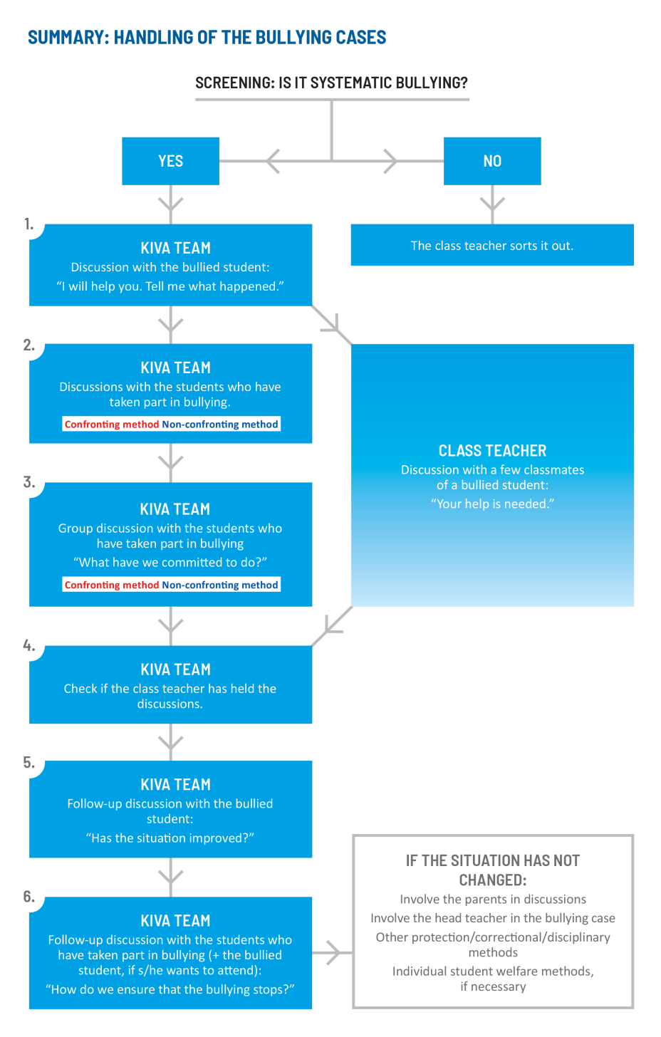
Notes:
Always inform parents!

Slide 29
4. Cooperation with the parents
Parents are always informed about the cases that have been addressed by the KiVa team.
The parents can be invited to the school to discuss about the case if needed, although this does not happen automatically in all cases. The students are first given a chance to change their behaviour.
Indicated actions – Tackling bullying

Slide 30

Catholic Social Teaching
Catholic social teaching (CST) is rooted in Scripture, formed by the wisdom of Church leaders, and influenced by grassroots movements. It is our moral compass, guiding us on how to live out our faith in the world.
Our faith calls us to love God and to love our neighbours in every situation, especially our sisters and brothers living in poverty. Following in the footsteps of Christ, we hope to make present in our unjust and broken world, the justice, love and peace of God.

Slide 31
7 core principles – rooted in scripture
Dignity
Solidarity
The common good
The option for the poor
Peace
Care for creation
The dignity of work and participation
Notes:
Dignity - We believe very human person is made in the image and likeness of God. This is a gift that we all share as fellow human beings; we are all infinitely loved by our Creator.
God is present in every human person, regardless of religion, culture, nationality, orientation or economic standing. Each one of us is unique and beautiful. We are called to treat every person and every creature with loving respect.
Solidarity arises when we remember that we belong to each other. We reflect on this in a special way at Mass. The Catechism of the Catholic Church states, “The Eucharist commits us to the poor. To receive in truth the Body and Blood of Christ given up for us, we must recognise Christ in the poorest.”
Solidarity spurs us to stand side by side with our sisters and brothers, especially those living in poverty. – SCHOOL OF SANCTUARY LINK
The common good means that the fruits of the earth belong to everyone. No one should be excluded from the gifts of creation. Pope Paul VI spoke about this 50 years ago in his encyclical Populorum Progressio.
The option for the poor reminds us of God’s preferential love for the poorest and most vulnerable people. God’s love is universal; he does not side with oppressors, but loves the humble.
Peace is a cornerstone of our faith. Christ, the Prince of Peace, sacrificed himself with love on the cross.
Creation and environment- In the first pages of the Bible we read how God created the sun and the stars, the water and earth, and every creature. We believe Christ is the redeemer of all creation.
The dignity of work has been a key principle of Catholic social teaching from the very beginning.
In 1891, Pope Leo XIII issued Rerum Novarum (On Capital and Labour). He shone a light on the injustice and exploitation of workers by the rich during the Industrial Revolution. He advocated for workers to join forces and fight against inhuman conditions.

Slide 32
Catholic Social Teaching clip
https://www.youtube.com/watch?v=XNcBCPVbYDU

Slide 33
Catholic Social Teaching
Activity 3:
7 Principles of Catholic Social Teaching
PADLET ACTIVITY
KiVa antibullying programme® and bullying

Slide 34
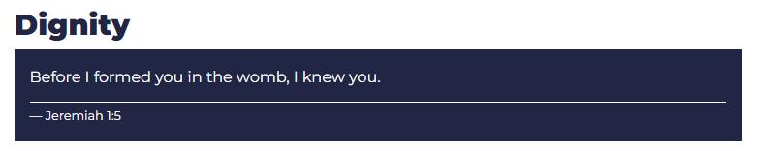
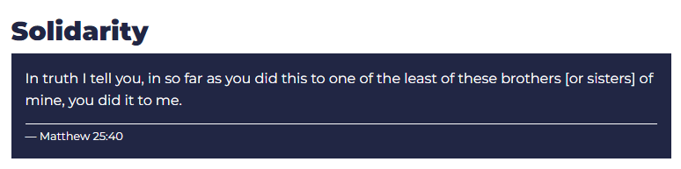
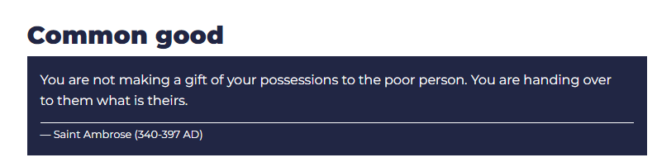
Before I formed you in the womb, I knew you.
Jeremiah 1:5

Slide 35
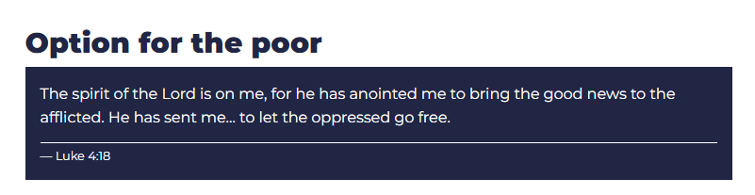
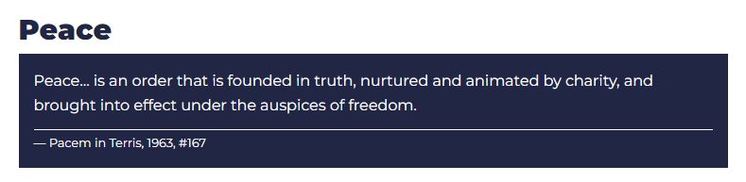
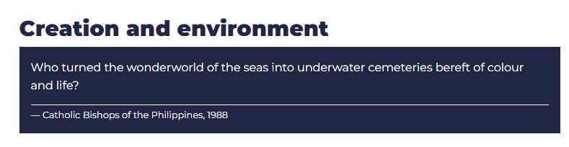
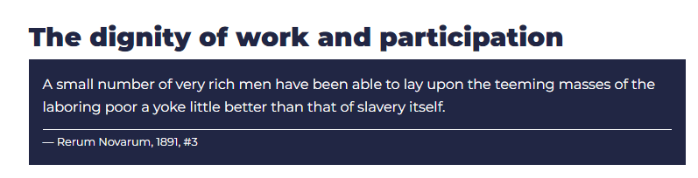

Slide 36
As a Catholic School, we must ensure our pupils;
understand and embrace the distinctive Catholic identity, charism and mission of their school. They value it greatly and are able to tell its unique story as part of the local and universal Church. Their active participation significantly enhances the Catholic life and mission of the school.
Take a leading role in responding to the demands of Catholic Social Teaching and are pro-active in finding ways of responding, locally, nationally and globally.
Pupils show a deep respect for their own personal dignity and that of others, who are made in the image and likeness of God. They demonstrate a deep sense of respect for those of other faiths, religions and none.

Slide 37
Implementation of the KiVa antibullying programme
Pupil surveys completed July 2022
Staff Inset – Monday 5th September 2022
Pupil launch – Friday 9th September 2022 – Introduce Champions of Christ
Parent Launch – During Transition meetings w/c 12th September 2022 (slides provided to include in ppt)
KiVa Team Initial meeting – Thursday 8th September 2022

Slide 38
Weekly certificates (Monday assembly)
Champion Tuesday – Champions of Christ observe pupils being ‘caught being kind’. 2 each.
Section on the newsletter.
Shared language across the school.
New page on the website.
Termly assemblies to launch competitions. First competition – To design a poster. Launched in first assembly.
Evidence in RE/Catholic Life floor books- work from the back please.
KS2 display

Slide 39
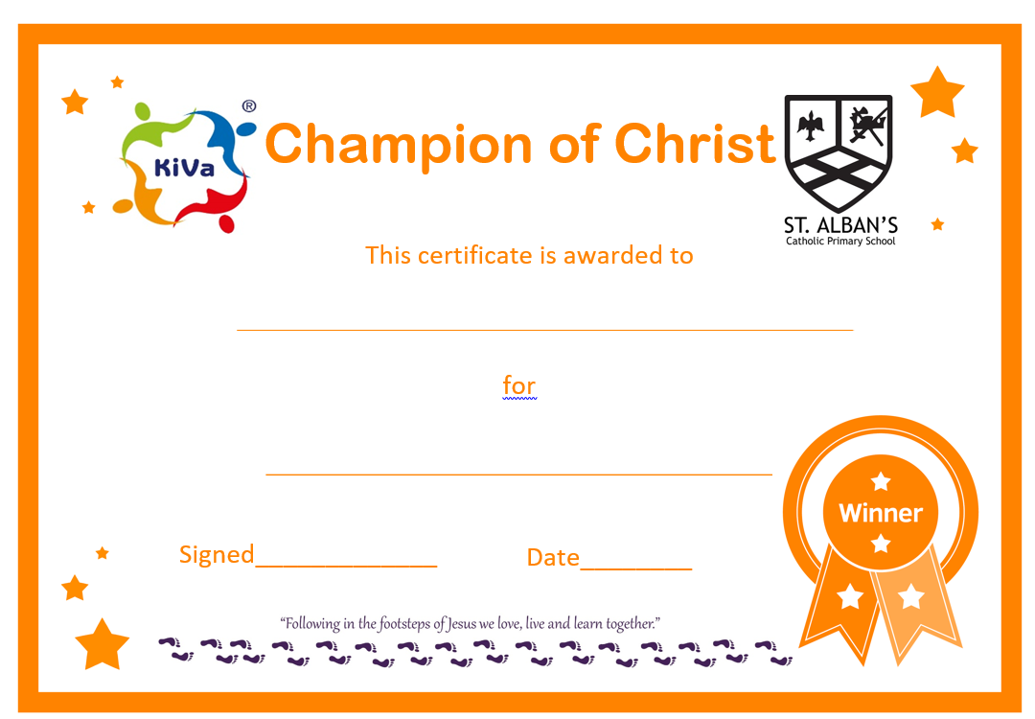

Slide 40

St. Alban’s Catholic Primary School
Behaviour
Visible Consistency, Visible Kindness

Slide 41
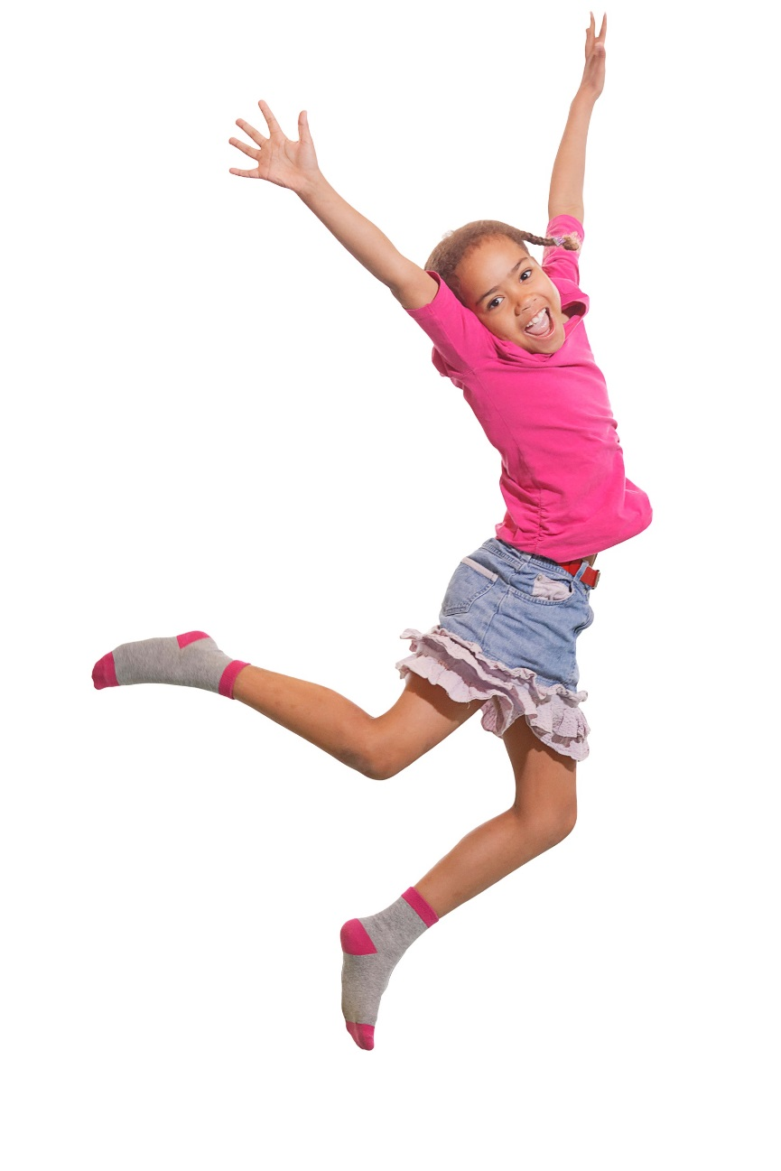
Kiva lessons for primary school
Year 3 to 4
  Let’s get to know each other!
  Emotions
  Our class – everyone is included!
  Difference is richness
  We say NO to bullying
  We will not join in on bullying
  The bullied child needs your help
  I will not be bullied!
  Literature lesson
  The KiVa contract
Universal actions – Lessons and themes

Slide 42

KiVa lessons for primary school
Year 5 to 7
  Respect is for everyone
  In a group
  Recognise bullying
  Hidden forms of bullying
  Responsible online
  Consequences of bullying
  The group and bullying
  Communicating support
  Stick up for yourself
  KiVa school – let’s do it together
Universal actions – Lessons and themes

Slide 43
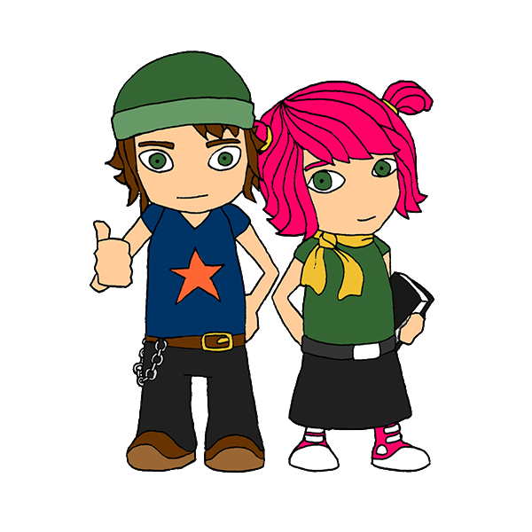
The KiVa contract
KiVa rules are built during the school year.
The core message of the lesson is summed up in the rule.
Each class to create and sign a contract (proforma provided).
The 1st rule:
We treat everyone with respect.
Universal actions – Lessons and themes

Slide 44

KiVa rules are summed up in the KiVa contract at the end of the school year.
Universal actions – Lessons and themes

Slide 45







Activities included in the lessons and themes
Group discussion
Small group discussion
Video
Visualisation exercise
Learning by doing
Booklet assignment
Homework
Universal actions – Lessons and themes

Slide 46
KiVa themes
  Start up: Let’s become a group!
  Theme 1: Interaction in a group
  Motto: Resist the pressure!
  Theme 2: Me and others
  Motto: I got to be me, you get to be you
  Theme 3: Forms and mechanisms of bullying
  Motto: No one deserves to be bullied
  Theme 4: Consequences and counterforces of bullying
  Motto: It’s up to us!
Universal actions – Lessons and themes

Slide 47


Online materials related to the KiVa lessons
KiVa Game 1
Unit 1
KiVa Game 2
Unit 2
Universal actions – Lessons and themes

Slide 48
Online materials support the assimilation of the lesson topics.
revision additional material exercises motivation
Games are available at App Store and Google Play.
Universal actions – Lessons and themes

Slide 49
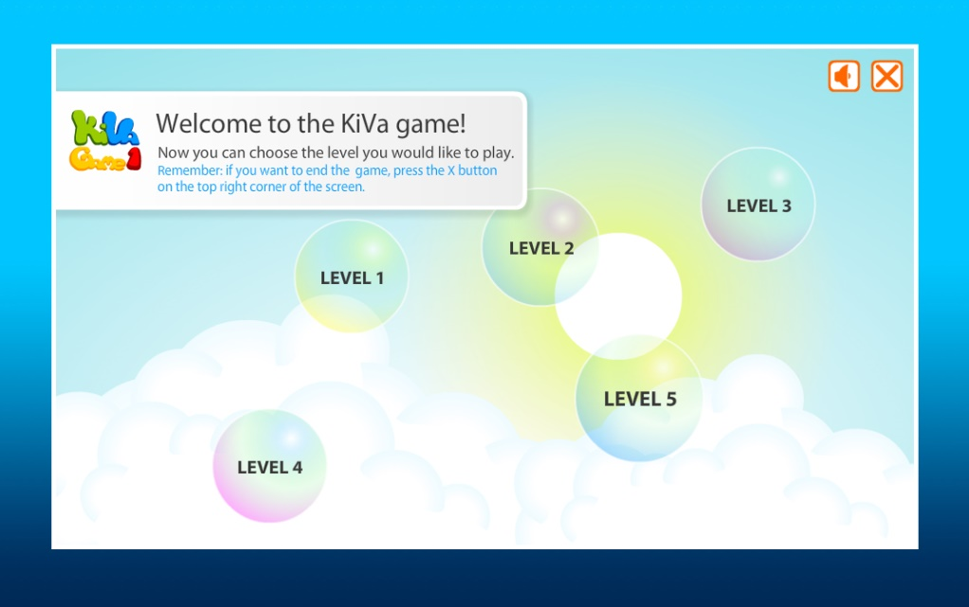
KiVa Game 1
The game has five levels, which are to be played after the corresponding lessons.
Lesson 4 Level 1
Lesson 6 Level 2
Lesson 7 Level 3
Lesson 8 Level 4
Lesson 10 Level 5
Universal actions – Lessons and themes

Slide 50
KiVa Game 2
The game has five levels, which are to be played after the corresponding lessons.
Every level consists of three sections.
Lesson 3 Level 1
Lesson 6 Level 2
Lesson 8 Level 3
Lesson 9 Level 4
Lesson10 Level 5
Universal actions – Lessons and themes

Slide 51
KiVa Game 2
  I KNOW: pupils learn about bullying, they are tested for what they have learned during the lessons.
  I CAN: pupils learn skills, which can be used in efforts to reduce bullying
  I DO: pupils apply things they have learned, reflect on their own actions, and report about them.
Universal actions – Lessons and themes

Slide 52
Information for the parents- Transition Meetings
Materials
http://data.kivaprogram.net/parents/
  Information about bullying
  Information about, how parents can help in reducing bullying and support a bullied child.
Universal actions – Lessons and themes

Slide 53
There’s a lot of material!
Choose the most suitable for your class (and for yourself).
  Teachers and classrooms are different
It’s recommended to cover all the lessons during one school year.
Universal actions

Slide 54
Group activity
Have a go at teaching a lesson with a group.

