Slide 1



KiVa – Anti-Bullying Programme

Slide 2
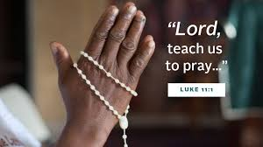
Let us pray…
Dear Lord,
Help me to demonstrate kindness everywhere I go. Remind me to share smiles, share friendship, and spread kindness today and always.
Amen.

Slide 3
Our school is part of the KiVa Anti-bullying programme
What is a school with a positive environment like?
LET’S THINK OF EXAMPLES...

Slide 4
What is a KiVa school like?
  KiVa stands for:
  Against bullying
  Antibullying
  In Finnish, KiVa means ‘kind’

Slide 5
The KiVa program
KiVa lessons in KS2
KiVa online games
Our school has a KiVa team which will tackle bullying cases
KiVa Champions
BULLYING WILL NOT BE TOLERATED IN THIS SCHOOL!

Slide 6
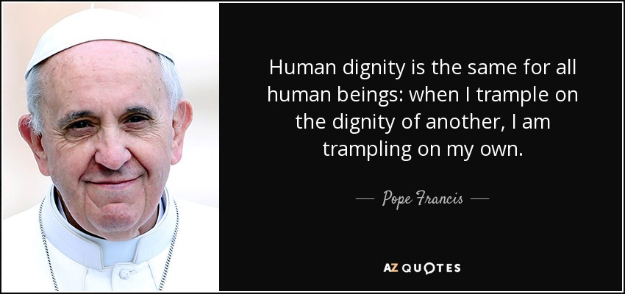

Slide 7
What does Jesus teach us about kindness?
“Let all bitterness and wrath and anger and clamour and slander be put away from you, along with all malice. Be kind to one another, tender-hearted, forgiving one another, as God in Christ forgave you.
Ephesians 4:31-5:1

Slide 8
What is bullying?

Slide 9
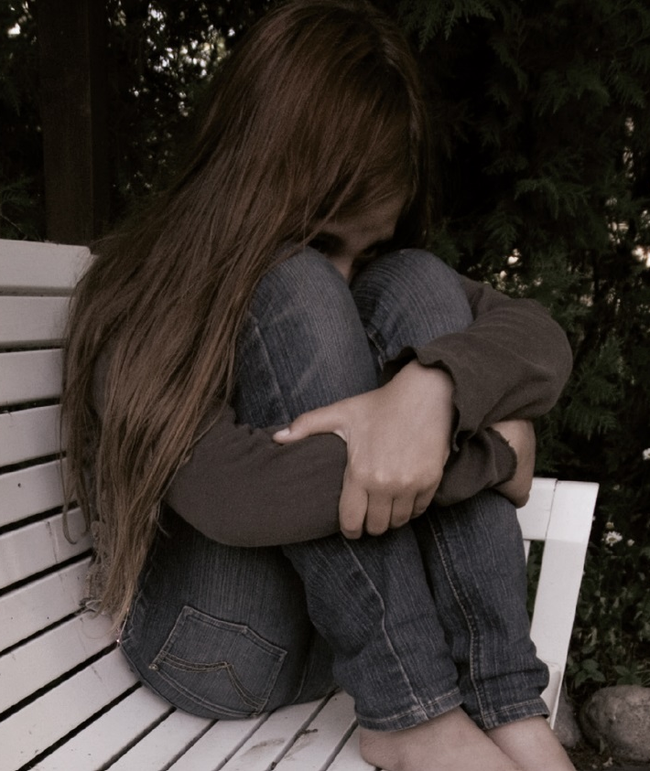
What is bullying?
Harmful behaviour which is;
  Repeated
  Imbalance of power
KiVa antibullying programme® and bullying
Notes:
Why do we need to define bullying? See page 6 in the Teacher’s manual.
A commonly used definition of bullying is that bullying is intentionally and repeatedly causing distress or harm to the same individual. In addition, it is difficult for the bullied children to defend themselves. This refers to the power imbalance between the parties – the bullied child usually has less power or physical strength than the bully or bullies.

Slide 10
  Repeatedly
Someone is being bullied when one or more children:
Say mean or hurtful things about them
Make fun of them
Ignore or exclude them
Leave them out on purpose
Try to make other children dislike them by saying mean things
Hit, kick or hurt them on purpose.
Notes:
It is bullying when these things happen repeatedly, and the bullied student finds it difficult to defend themselves.
It is also bullying when a pupil is teased repeatedly in a mean or hurtful way.

Slide 11
What is not bullying?
Bullying is not;
  Friendly or playful teasing
  An argument, or
  A fight
KiVa antibullying programme® and bullying
Notes:
What is not bullying?
It must be repeated.

Slide 12
Forms of bullying
Verbal bullying (name-calling, saying mean things)
Indirect bullying (exluding a person from group, spreading mean stories about him/her)
Physical bullying (pushing, hitting, kicking)
Cyberbullying
KiVa antibullying programme® and bullying
Notes:
Most often bullying is verbal (name-calling, public ridicule).
Indirect bullying (exluding a person from group, spreading mean stories about him/her) is also quite common.
Physical bullying (pushing, hitting, kicking) is not that common.
Cyberbullying

Slide 13
  Repeatedly

Slide 14
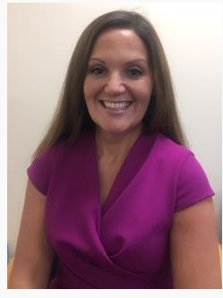

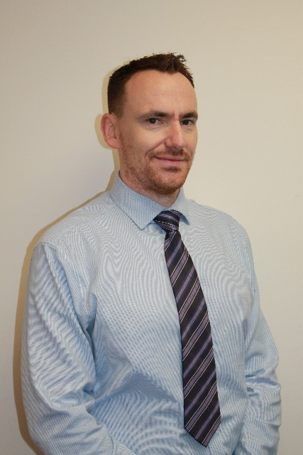
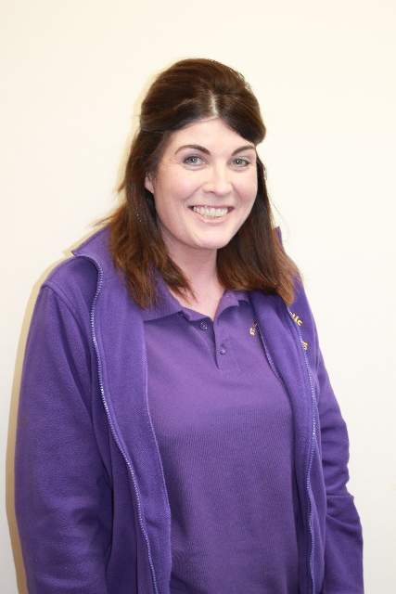
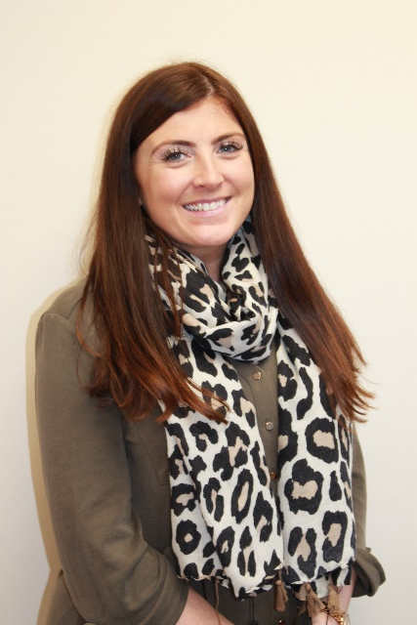
KiVa Anti-Bullying Programme
The Kiva Team
Mr Griffin
Mrs McKinney
Mrs Doherty
Mrs Donnellan
SPEAK OUT…WE ARE HERE TO HELP!
Who is your class KiVa Champions’?

Slide 15

What does it mean to be a KiVa Champion?

Slide 16
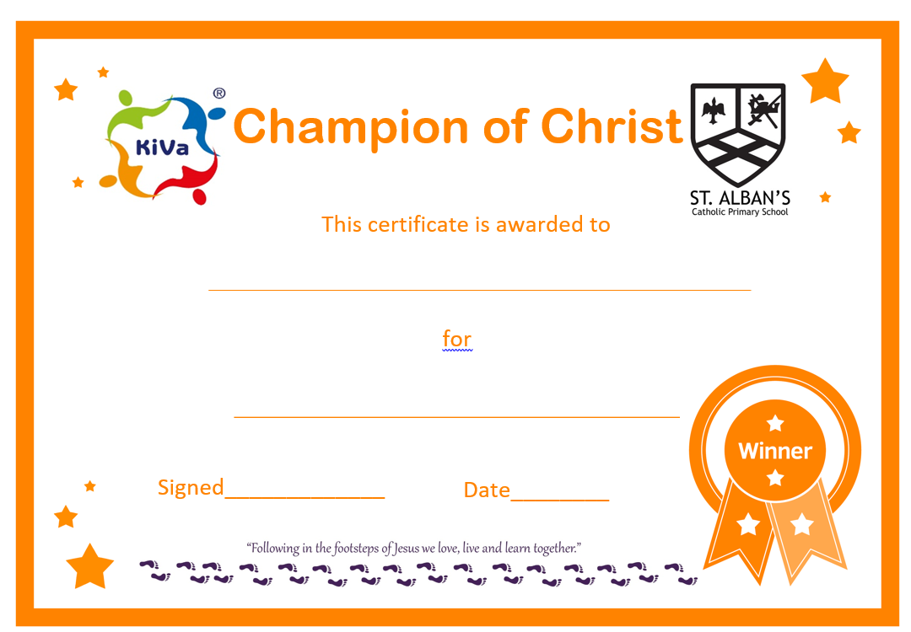

Slide 17
HOW CAN WE MAKE A DIFFERENCE?
We all have a responsibility!

Slide 18

Summer Competition
Design a KiVa poster!
Deadline: Monday 15th May 2023

Slide 19
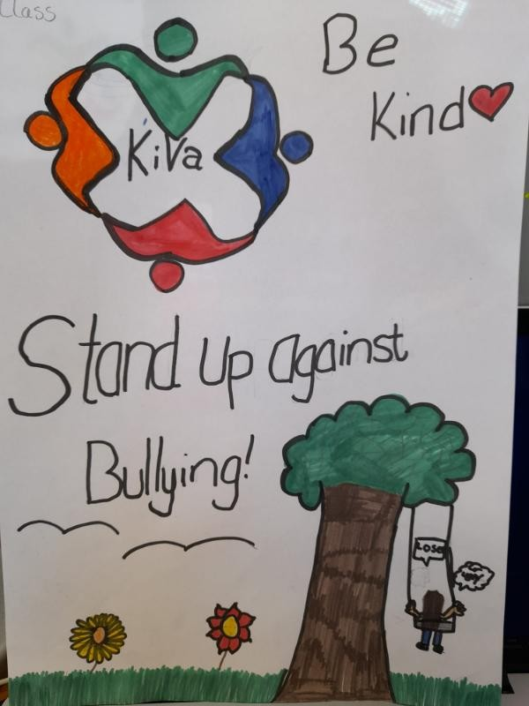
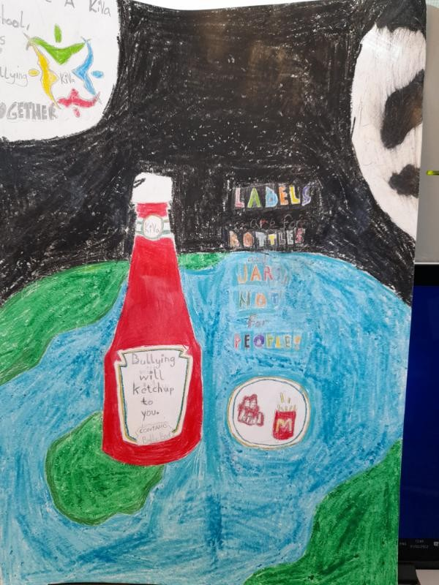

Slide 20
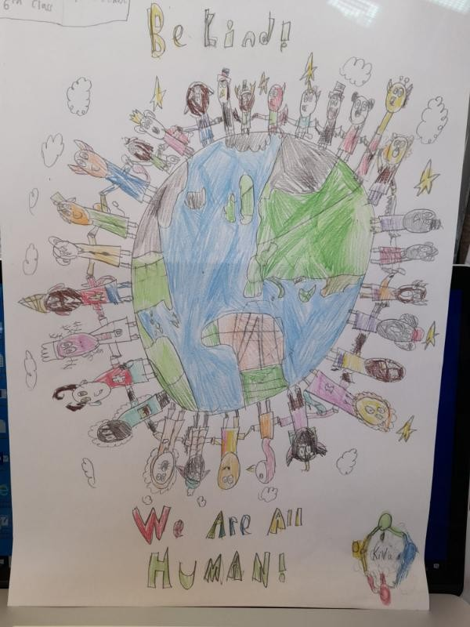
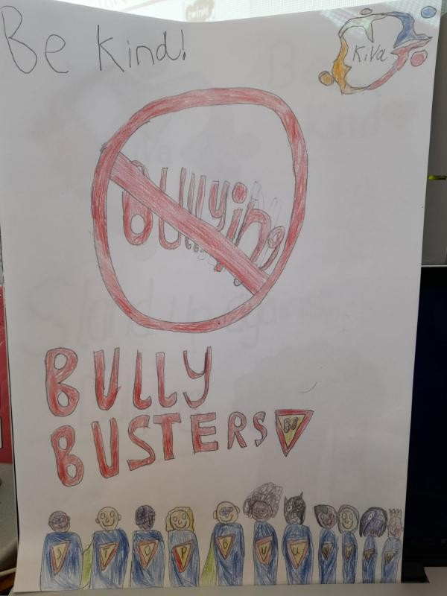

Slide 21
Summer Competition
Design a KiVa poster!
Deadline: Monday 15th May 2023

Slide 22


