Slide 2
KiVa antibullying programme®
An evidence-based programme to prevent and reduce bullying
Developed at the University of Turku, Finland (funded by the Finnish Ministry of Education and Culture)
Broadly used in Finland and in other countries (www.kivaprogram.net)
KiVa antibullying programme® and bullying

Slide 3
Goals
To prevent new bullying cases from emerging
To tackle bullying cases effectively
To minimise the negative effects caused by bullying
KiVa antibullying® and bullying

Slide 4
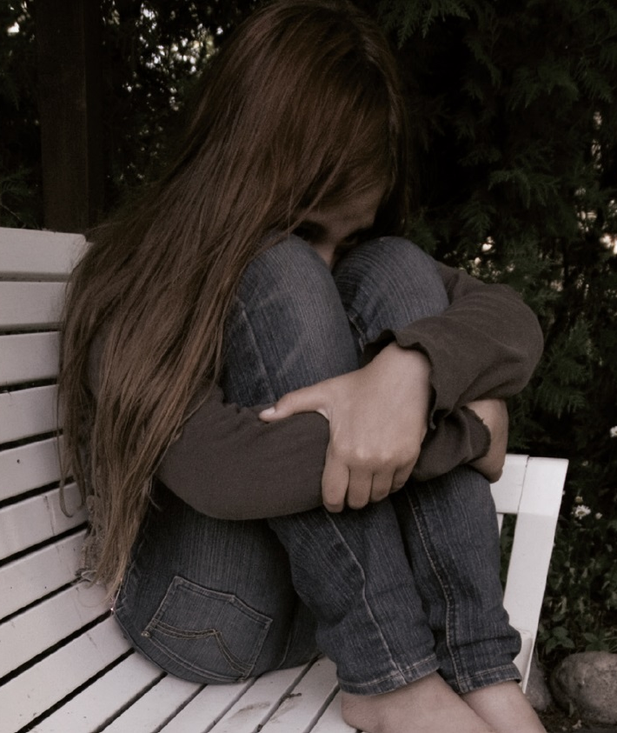
What is bullying?
Harmful behaviour/
degrading treatment, which is
  repeated
  targeted at a relatively defenseless or a less powerful person
KiVa antibullying programme® and bullying

Slide 5
What is not bullying?
Bullying is not...
  a conflict,
  an argument, or
  a fight.
Instead, it is a manifestation of a repressive relationship; an abuse of power and strength.
KiVa antibullying programme® and bullying

Slide 6
Forms of bullying
Most often bullying is verbal (name-calling, public ridicule).
Indirect bullying (exluding a person from a group, spreading mean stories about him/her) is also quite common.
Physical bullying (pushing, hitting, kicking) is not that common.
KiVa antibullying programme® and bullying

Slide 7
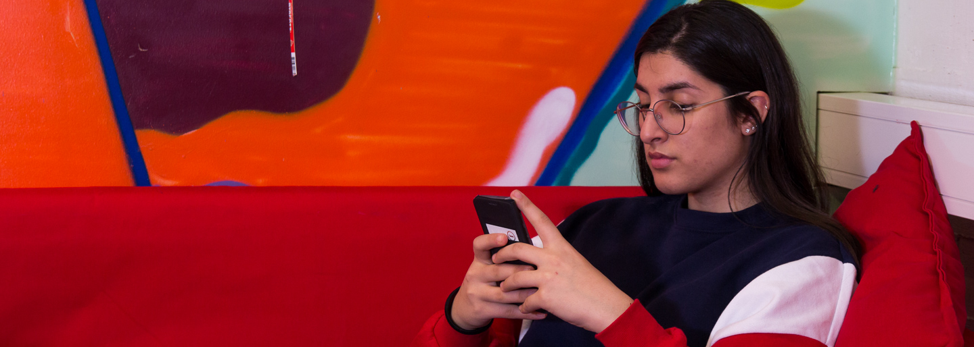
Cyberbullying has increased, although the prevalence of it is still relatively low (in comparison with other forms of bullying). The targets of cyberbullying are almost always bullied in other ways as well.
KiVa antibullying programme® and bullying

Slide 8
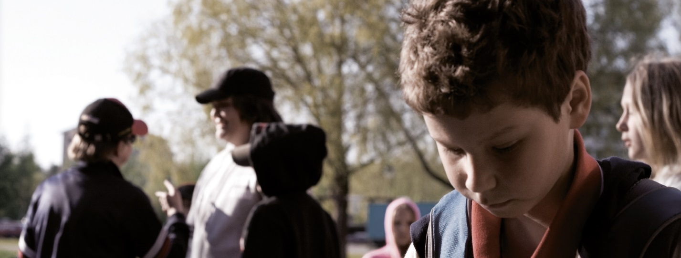
When defining bullying, the focus is not on the form of bullying, but rather if the actions are deliberate and systematic.
A bullied child or adolescent is usually bullied in many ways.
KiVa antibullying programme® and bullying

Slide 9
If you wish, you can add here
the results of your school’s survey
KiVa antibullying programme® and bullying

Slide 10
KiVa antibullying programme
Universal actions
Indicated actions
  Coordination of the programme
  KiVa lessons and themes
  Communication with the parents
  Student and staff surveys
  Posters, vests for breaktime and midday supervisors
  Tackling acute cases of bullying
  The KiVa team in the school + cooperation with the classroom teacher
KiVa antibullying programme® and bullying

Slide 11
Universal actions
For all students and parents

Slide 12
Bullying does not concern only the bullies and the bullied students
Most children do not accept bullying
Many, however end up following the bully or keeping quiet.
Only a few support the bullied student.
Universal actions - Coordination

Slide 13
Bullying-related group norms often dictate, that being friends with the bullied student is not allowed; you’re not supposed to accept him/her.
The bullied student’s status in the group continues to worsen over time.
Universal actions - Coordination

Slide 14
It’s important that all the students understand that they can make a difference!
  ”Let’s stop bullying together!”
  This is the goal of the Universal actions in the KiVa antibullying programme.
Universal actions - Coordination

Slide 15
KiVa lessons and themes form a continuum during the basic education
Lesson plans (Teacher’s manual)
KiVa games
Universal actions – Lessons and themes

Slide 16
KiVa lessons and themes form a continuum during the basic education
Primary school:
  Lessons for years 3 - 4: 10 double lessons
  Lessons for years 5 - 6: 10 double lessons
Lower secondary school:
  Themes for years 7 - 11: 4 themes
Universal actions – Lessons and themes

Slide 17

A student is part of the KiVa school the whole time, but is engaged more in the programmes’s actions in the target years (year 3 to 11)
Certain topics are dealt year after year in an age- approptiate way.
Universal actions – Lessons and themes

Slide 18
Goals for the lessons and themes:
  Getting the children to understand the role a group plays in bullying.
  Increasing empathy for the bullied students.
  Learning ways to support the bullied student, and taking responsibility for not allowing bullying to occur in the group.
Universal actions – Lessons and themes

Slide 19

Kiva lessons for primary school
Years 3 and 4
  Let’s get to know each other!
  Emotions
  Our class – everyone is included!
  Difference is richness
  We say NO to bullying
  We will not join in on bullying
  The bullied child needs your help
  I will not be bullied!
  Literature lesson
  The KiVa contract
Universal actions – Lessons and themes

Slide 20

KiVa lessons for primary school
4th grade
  Respect is for everyone
  In a group
  Recognise bullying
  Hidden forms of bullying
  Responsible online
  Consequences of bullying
  The group and bullying
  Communicating support
  Stick up for yourself
  KiVa school – let’s do it together
Universal actions – Lessons and themes

Slide 21
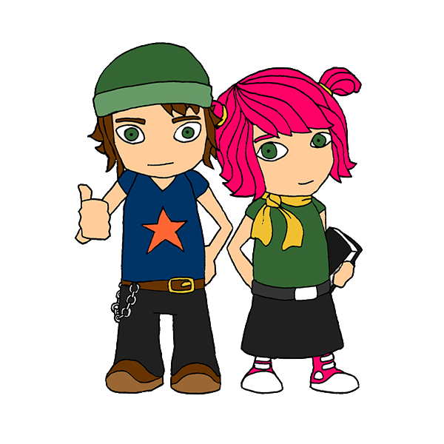
The KiVa contract (primary school)
The KiVa rules are built during the school year.
The core message of the lesson is summed up in the rule.
The 1st rule:
We treat everyone with respect.
Universal actions – Lessons and themes

Slide 22
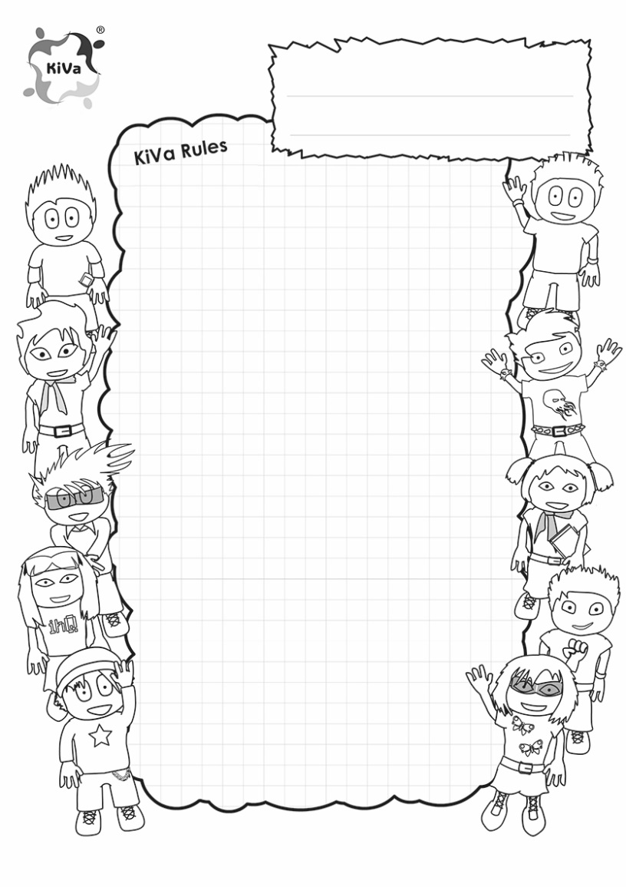
KiVa rules are summed up in the KiVa contract at the end of the school year.
Universal actions – Lessons and themes

Slide 23







Activities included in the lessons and themes
Group discussion
Small group discussion
Video
Visualisation exercise
Learning by doing
Booklet assignment
Homework
Universal actions – Lessons and themes

Slide 24
Universal actions – Lessons and themes

Slide 25


Online materials related to the KiVa lessons
KiVa Game 1
Unit 1
KiVa Game 2
Unit 2
Universal actions – Lessons and themes

Slide 26
The online materials support the assimilation of the lesson topics.
revision additional material exercises motivation
The games are available at App Store and Google Play.
Universal actions – Lessons and themes

Slide 27
Information for the parents
Materials
Parents’ evening
http://data.kivaprogram.net/parents/
  Information about bullying
  Information on how the parents can help in reducing bullying and support a bullied child.
Universal actions – Cooperation with the parents

Slide 28
What could parents do to reduce bullying?
Take any bullying situation seriously
Cooperate with the school
  inform the school about a bullying case
  trust in the school’s ability to handle the matter
Discuss bullying with your child / adolescent even if s/he is not being bullied or s/he is not bullying others
  Let’s encourage children / adolescents not to join in on bullying, to support the bullied students, and to tell adults about bullying!
Universal actions – Cooperation with the parents

Slide 29
Indicated actions
When bullying cases emerge

Slide 30
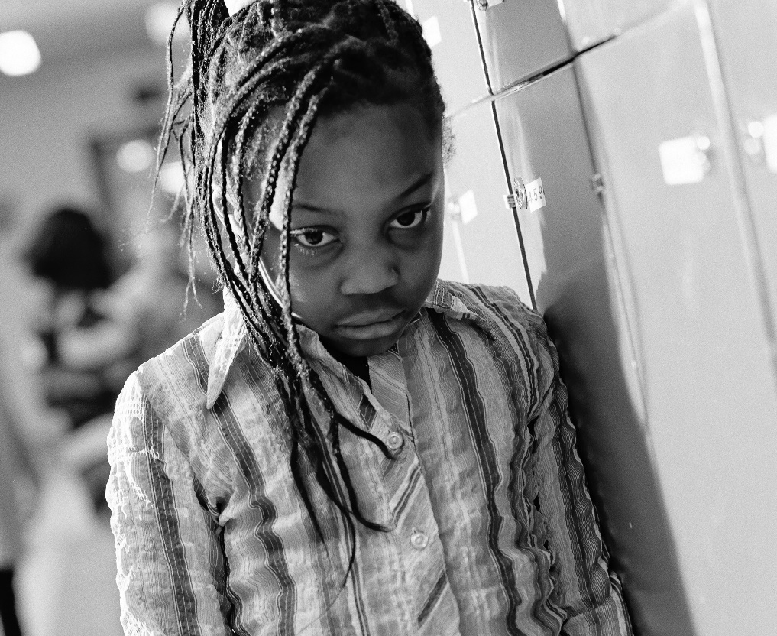
Tackling bullying
The KiVa team
Screening of bullying
Discussions
Cooperation with the parents
Indicated actions – Tackling bullying

Slide 31
1. KiVa team
When a suspected bullying case comes to attention, the KiVa team tackles the case in cooperation with the class teacher.
Indicated actions – Tackling bullying

Slide 32
2. Screening: is this bullying?
When the suspected bullying case comes to attention, the adult who is present or is first informed about the incident
  gathers the needed background information, and
  directs the case to the KiVa team, if it is a bullying case.
Indicated actions – Tackling bullying

Slide 33
3. Discussions
The KiVa team: discussions with the bullied student and the bully/bullies.
Class teacher: a discussion with a few classmates who are prosocial and a have good status: ”Your help is needed.”
Follow-up discussion with the bullied student and the bully/bullies.
Indicated actions – Tackling bullying

Slide 34
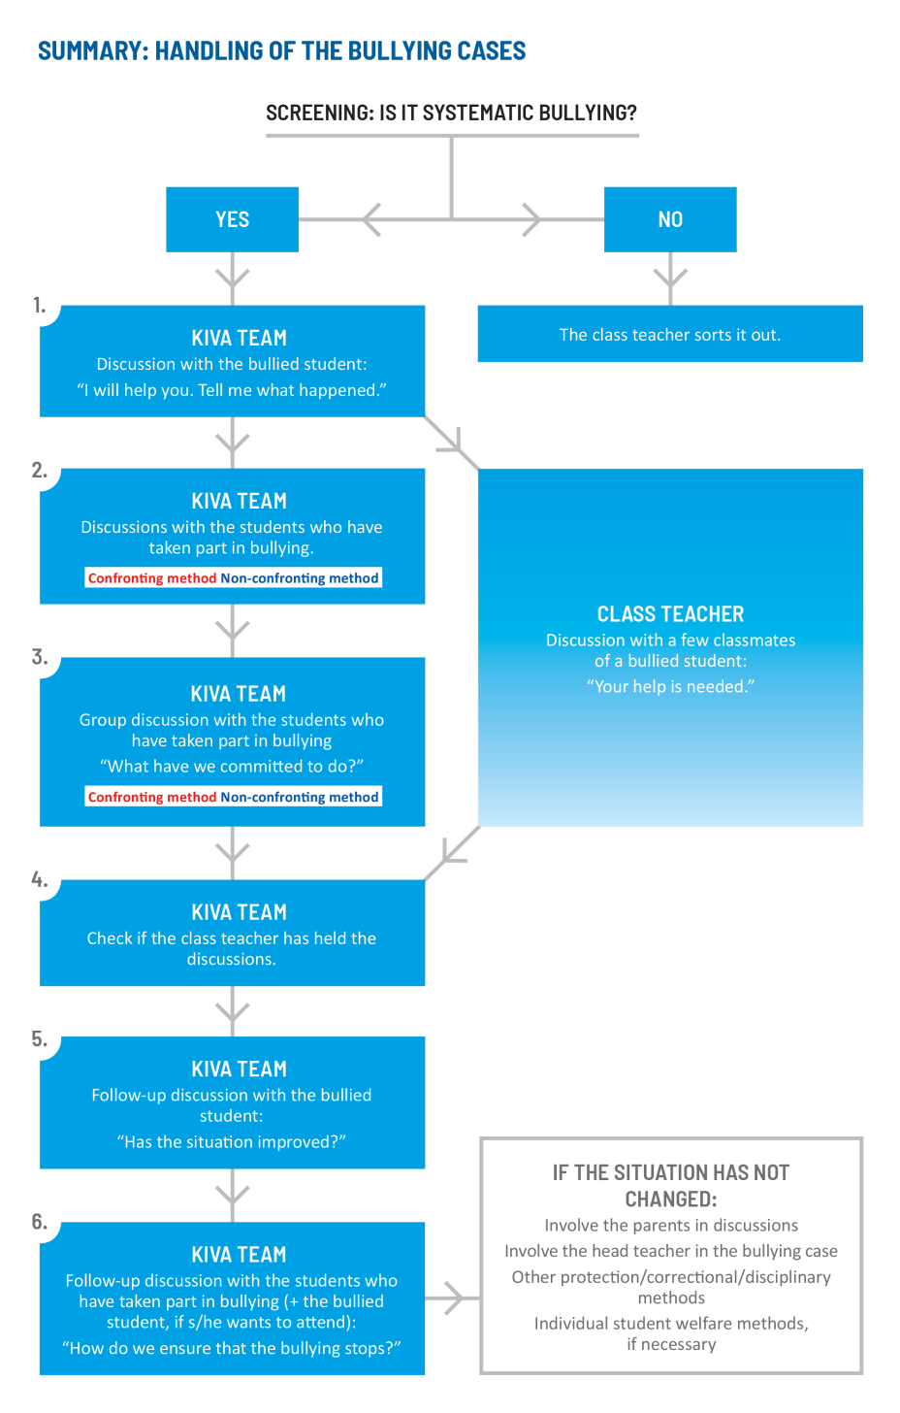
Indicated actions – Tackling bullying

Slide 35
4. Cooperation with the parents
The parents are always informed about the cases that have been addressed by the KiVa team.
The parents can be invited to the school to discuss about the case if needed, although this does not happen automatically in all cases. The students are first given a chance to change their behaviour.
Indicated actions – Tackling bullying

Slide 36
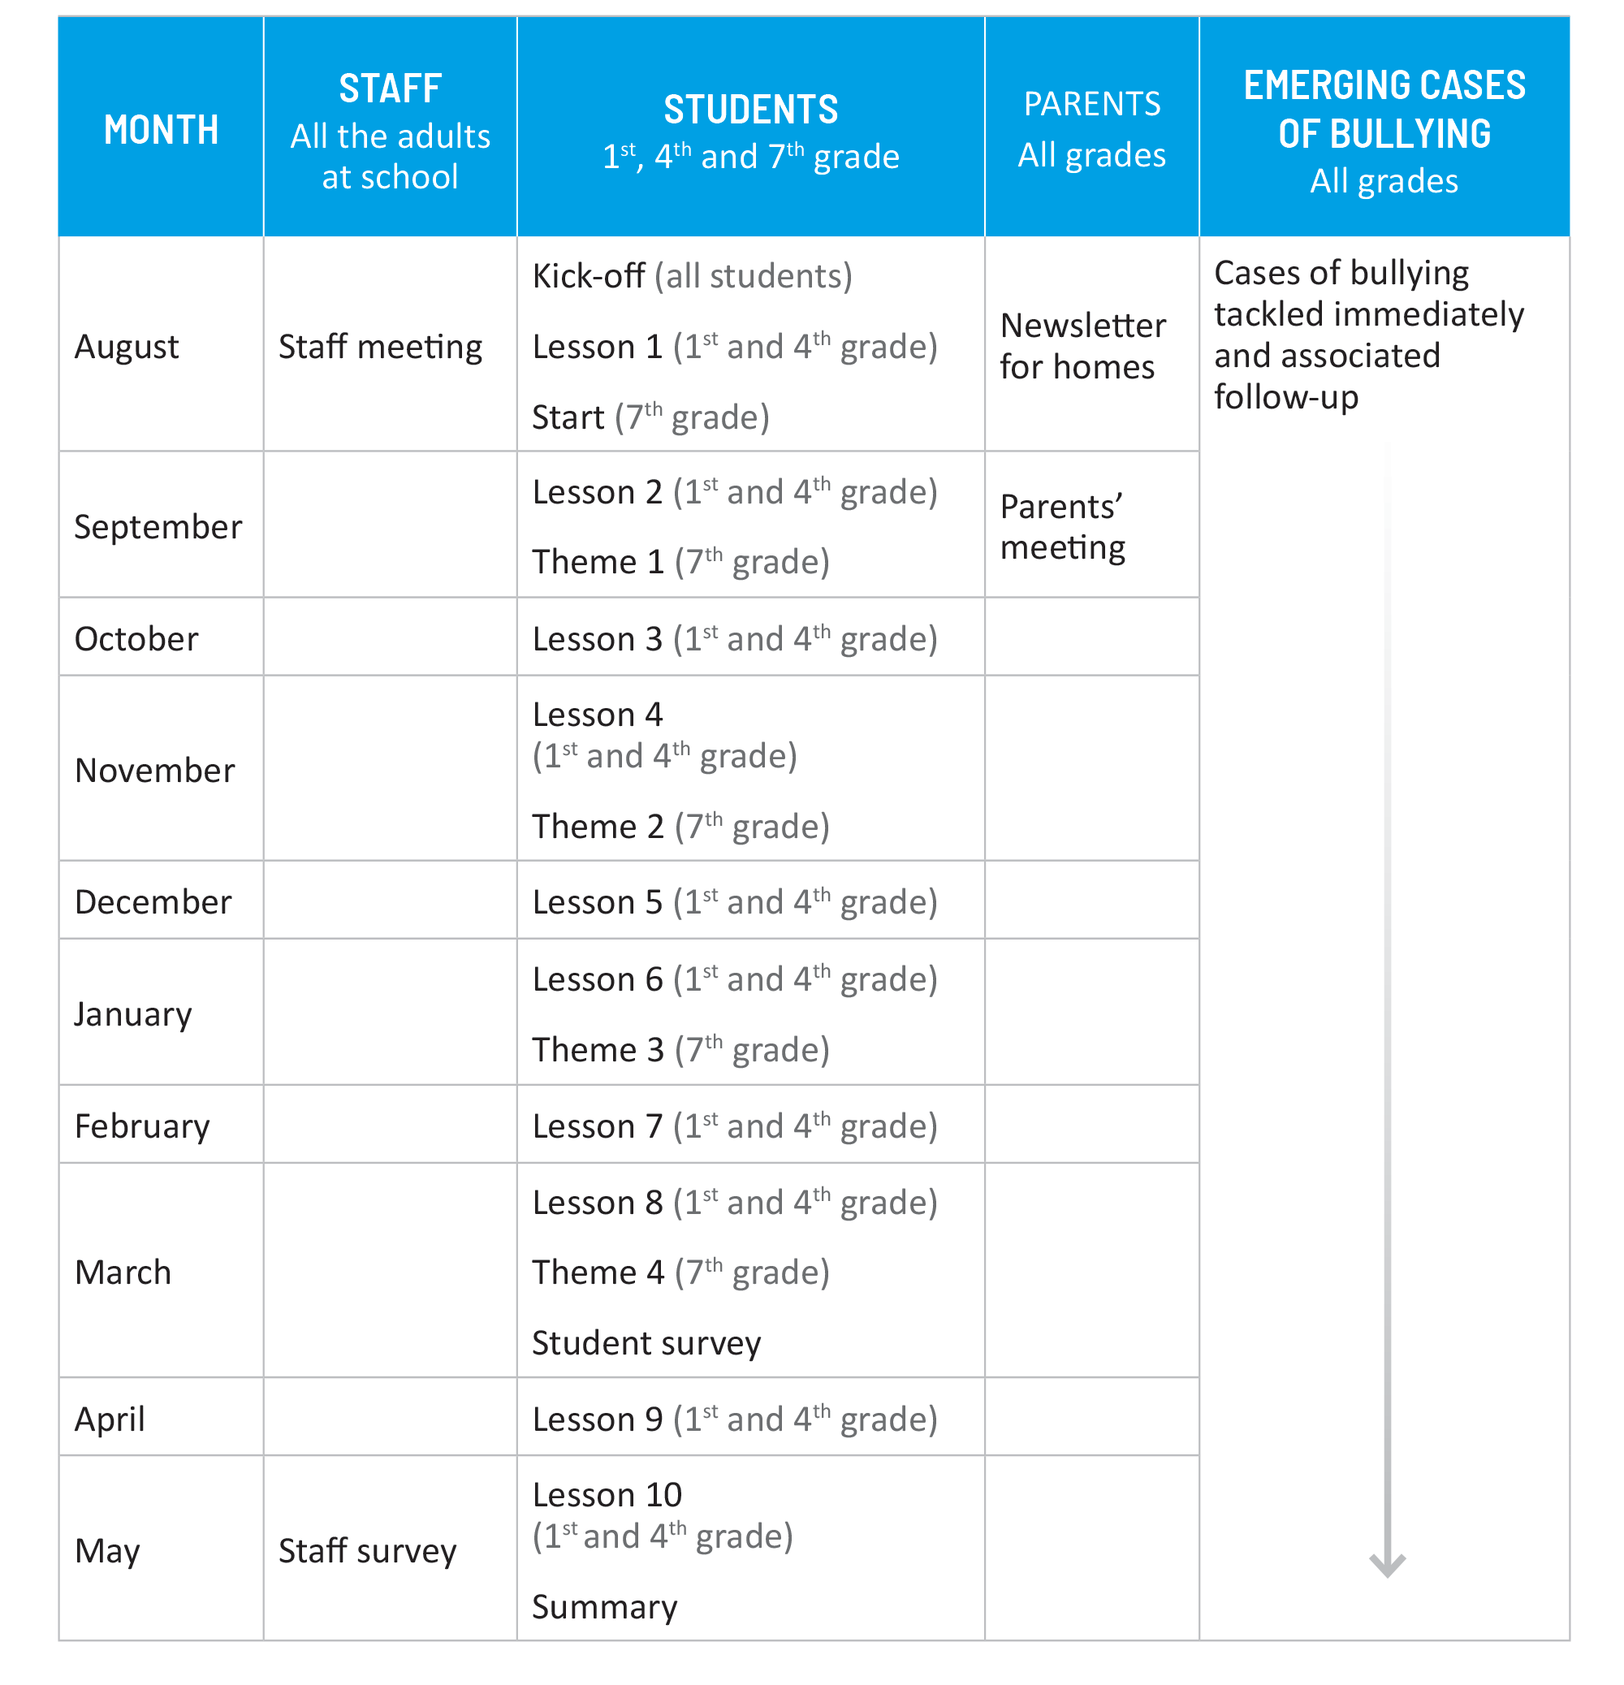
Recommended timetable for implementing the KiVa antibullying programme
The school year in a KiVa school

Slide 37
The effects of KiVa antibullying programme

Slide 38
Does KiVa antibullying programme have the desired effects?
The University has carried out studies on the effects of the programme
during the pilot phase (2007-2009) and
nationwide implementation of the programme (from 2009 onwards)
The effects of the KiVa antibullying programme

Slide 39

Pilot phase
Clear evidence that the programme reduces the prevalence of bullying and victimisation.
The effects of the KiVa antibullying programme – Pilot phase

Slide 40
Pilot phase: KiVa antibullying programme effects also others than just the bullies and bullied students!
The amount of defenders of the bullied student increased,
the amount of reinforcers of the bully decreased, and
students’ faith in their teacher’s ability to tackle bullying increased.
The effects of the KiVa antibullying programme – Pilot phase

Slide 41
Pilot phase: Positive ”side effects”?
Better class atmosphere
Increased motivation to go to school
  ’’My class has a good atmosphere.’’
  ’’Helping others is common in my class.”
  ’’I’m happy to be in this class.’’
  ’’Learning makes me happy.’’
  ’’I want to learn many things.”
  ’’I think I do well at school.’’
The effects of the KiVa antibullying programme – Pilot phase

Slide 42
Pilot phase: Bullying cases directed to the KiVa team
The KiVa teams tackled average 6.5 bullying cases per school
In 98% of the cases the bullied student felt that the situation had improved for the better!
The effects of the KiVa antibullying programme – Pilot phase

Slide 43
Broad implementation: The prevalence of bullying and victimisation can be followed with the help of the student and staff surveys
Since 2009 the students in the KiVa schools in Finland have been able to fill in the online student survey.
The amount of students answering to the survey annually
Year 2009 195 000 students 1190 schools
Year 2010 282 000 students 1688 schools
Year 2011 273 000 students 1695 schools
Year 2012 229 000 students 1396 schools
Year 2013 217 000 students 1321 schools
Year 2014 196 800 students 1201 schools
Year 2015 206 605 students 1196 schools
The effects of the KiVa antibullying programme– Broad implementation

Slide 44
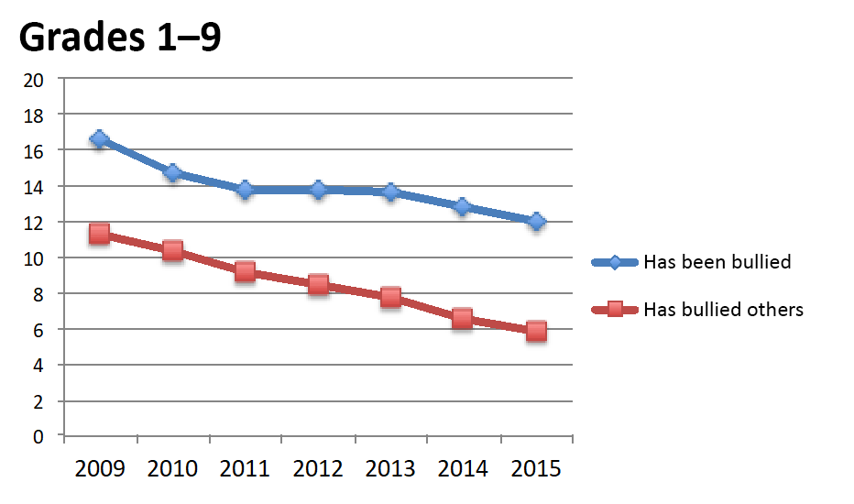
Prevalence of bullying during 2009-2015
According to the student survey results bullying decreases: the number of students that bully others has decreased 49% and students that have been bullied 28%.
These figures include all the schools that have taken part in student survey between 2009 and 2015.
The effects of the KiVa antibullying programme– Broad implementation

Slide 45
The implementation of KiVa antibullying programme reduces bullying
It’s particularly positive that it looks like the implementation of the programme decreases bullying and victimisation in the long run.
The amount of bullying others decreased by 43% between 2009 and 2015.
The amount of students being bullied decreased by 25% in primary schools between 2009-2015. These figures include all the schools that have taken part in the student survey between 2009 and 2015.
The effects of the KiVa antibullying programme – Broad implementation

Slide 46
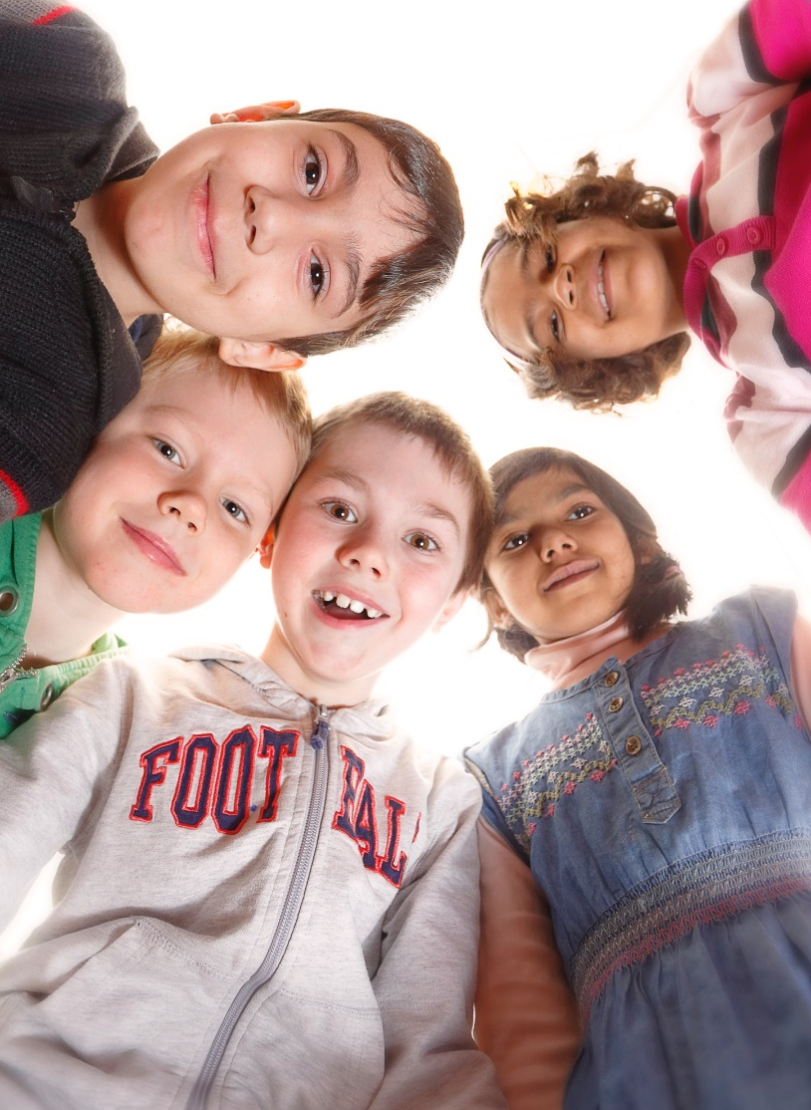
More information...
www.kivaprogram.net

