Slide 1
LKS2 Prayers

Slide 2
Apostles creed
I believe in God,
the Father almighty
Creator of heaven and earth,
And in Jesus Christ, his only Son, our Lord,
(At the words that follow up to and including the Virgin Mary, all bow)
who was conceived by the Holy Spirit,
Born of the Virgin Mary
Suffered under Pontius Pilate,
was crucified, died and was buried;
Notes:
Based on baptismal documents of the 8th century but related to texts of an earlier origin.

Slide 3
Apostles creed
he descended into hell;
on the third day he rose again from the dead;
he ascended into heaven,
and is seated at the right hand of God the Father almighty;
From there he will come to judge the living and the dead.
Notes:
Based on baptismal documents of the 8th century but related to texts of an earlier origin.

Slide 4
Apostles creed
I believe in the Holy Spirit,
the holy catholic Church,
the communion of saints,
the forgiveness of sins,
the resurrection of the body,
and life everlasting.
Amen
Notes:
Based on baptismal documents of the 8th century but related to texts of an earlier origin.

Slide 5
An Act of Contrition
O my God,
bcause you are so good,
I am very sorry that I have sinned against you,
and with the help of your grace
I will not sin again
Amen.
Notes:
One of the forms of the Penitent’s Prayer of Sorrow found in the Rite of Penance.

Slide 6

Prayer to the Guardian Angel
Angel of God, my guardian dear,
to whom God's love commits me here,
ever this day be at my side,
to light and guard, to rule and guide.
Amen.
Notes:
The prayer is based on one by Reginald of Canterbury in the early 12th century.

Slide 7
Prayer of St. Richard of Chichester
Day by day,
O dear Lord,
three things I pray:
to see you more clearly,
love you more dearly,
follow you more nearly,
day by day,
by day, by day.
Amen.

Slide 8
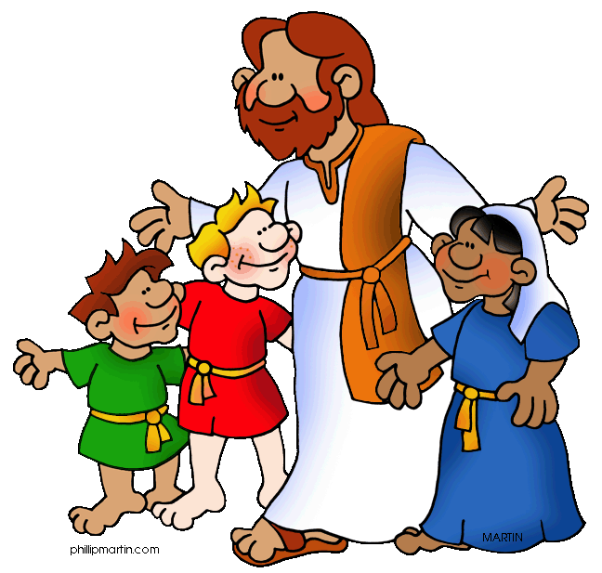
Act of Faith, Hope and Love
Jesus, I believe in you.
Jesus, I hope in you.
Jesus, I love you.

Slide 9


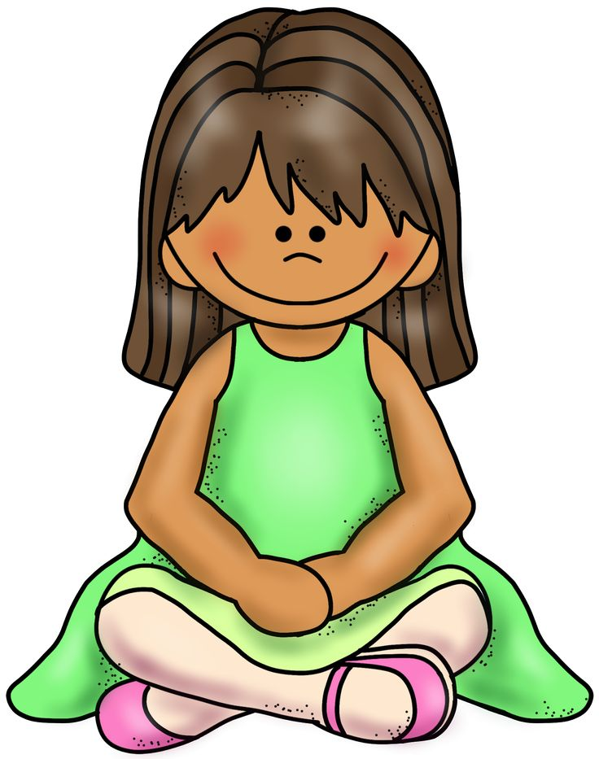
Act of Faith
My God, I believe in you
and all your Church teaches,
because you have said it
and your word is true.

Slide 10

Act of Hope
My God, I hope in you,
for grace and for glory,
because of your promises,
your mercy and power.

Slide 11

Act of Love
My God, because you are so good,
I love you with all my heart,
And for your sake,
I love your neighbour as myself

