Slide 1
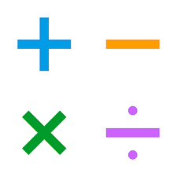

Calculation strategies for the 4 operations.
Year 3

Slide 2

Through our teaching at
St. Alban's we aim to ensure that all pupils:
become fluent in the fundamentals of mathematics, so that pupils develop conceptual understanding and the ability to recall and apply knowledge rapidly and accurately.
reason mathematically by following a line of enquiry, conjecturing relationships and generalisations, and developing an argument, justification or proof using mathematical language
can solve problems by applying their mathematics to a variety of routine and non-routine problems with increasing sophistication, including breaking down problems into a series of simpler steps and persevering in seeking solutions.

Slide 3
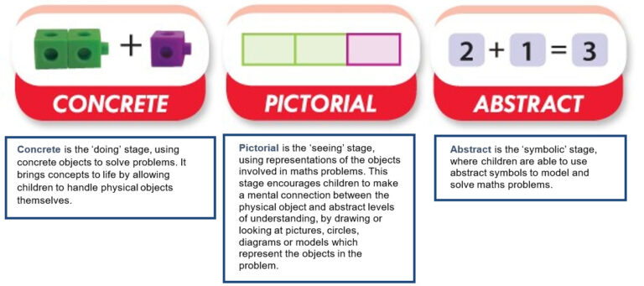
CPA Approach:

Slide 4
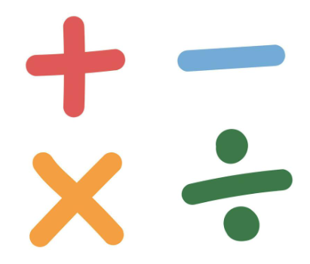
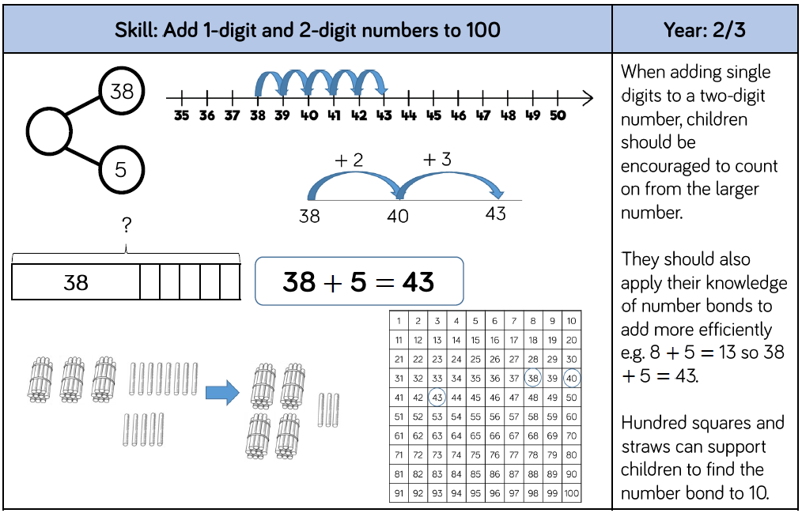
Addition and Subtraction in Year 3

Slide 5
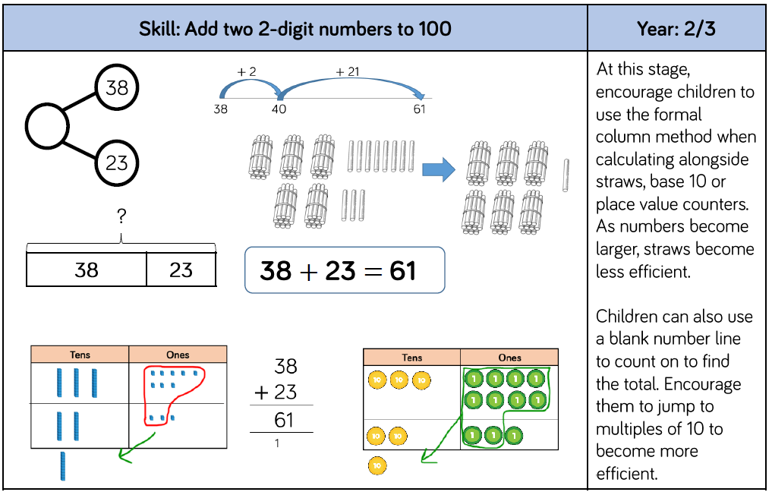
Addition and Subtraction in Year 3

Slide 6
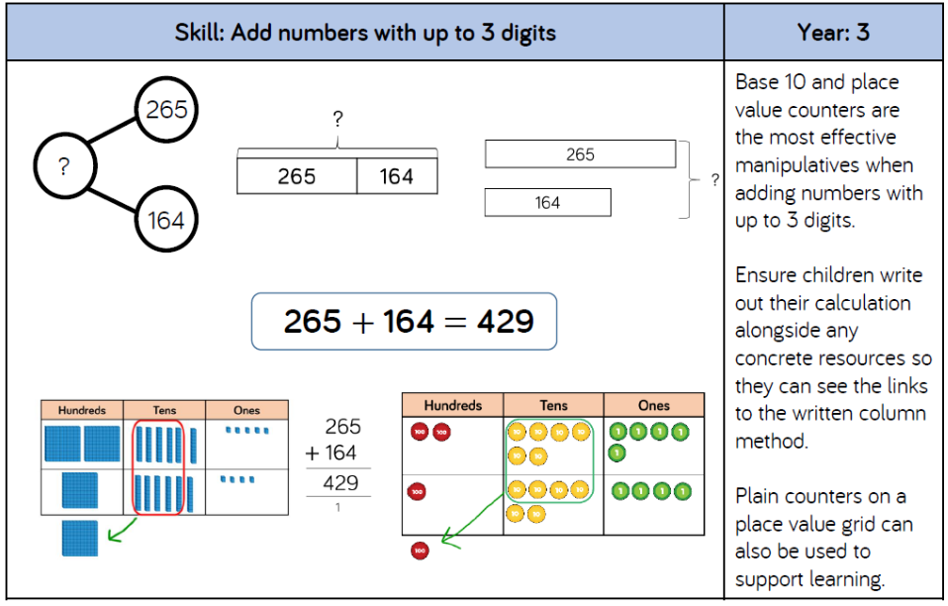
Addition and Subtraction in Year 3

Slide 7




Mo scores 243 points in a game.
Eva scores 108 points in a game.
How many do they score in total?
351
Hundreds | Tens | Ones
 | H | T | O
 | 2 | 4 | 3
 | 1 | 0 | 8
+
3
5
1
1
3
5
1
11
Have a think

Slide 8

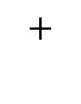
243 $+$ 172 $=$
415
Hundreds | Tens | Ones
 | H | T | O
 | 2 | 4 | 3
 | 1 | 7 | 2
$$+$$
4
1
5
1
4
11
5
1

Slide 9
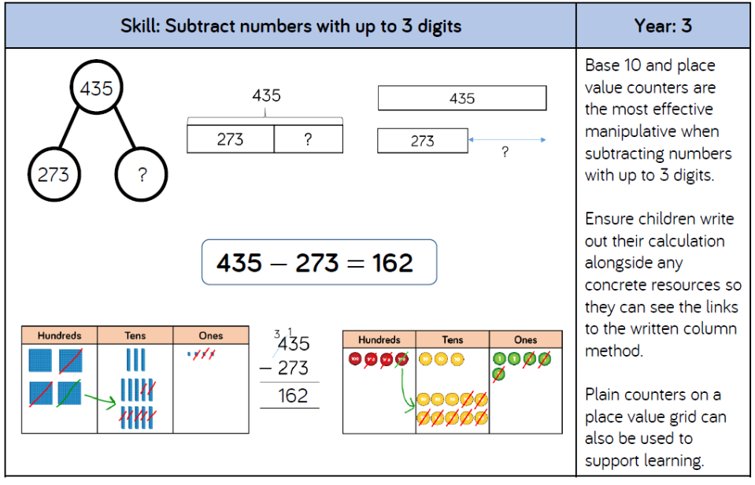
Addition and Subtraction in Year 3

Slide 10
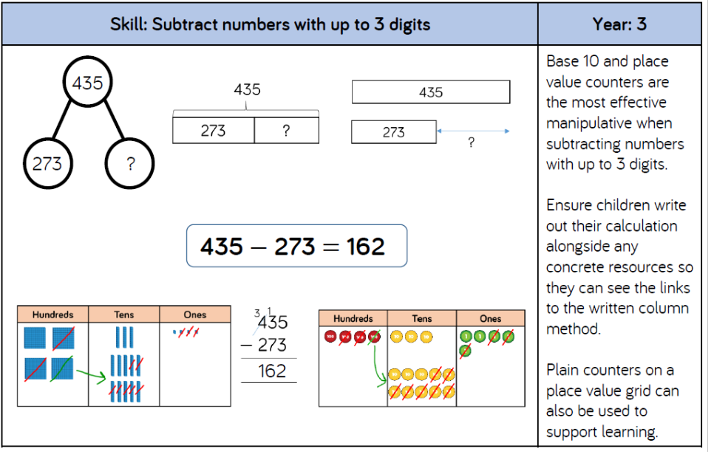
Addition and Subtraction in Year 3

Slide 11




451 $−$ 325 $=$
126
Hundreds | Tens | Ones
 | H | T | O
 | 4 | 5 | 1
 | 3 | 2 | 5
4
1
$$−$$
1
2
6
1
2
6
I will exchange 1 ten for 10 ones.

Slide 12





537 $−$ 252 $=$
285
Hundreds | Tens | Ones
 | H | T | O
 | 5 | 3 | 7
 | 2 | 5 | 2
4
1
$$−$$
2
8
5
2
8
5
4 hundreds subtract 2 hundreds is equal to ___ hundreds.
5
I will exchange 1 hundred to make 10 tens.
7 ones subtract 2 ones is equal to ___ ones.
3 tens subtract 5 tens.
8
13 tens subtract 5 tens is equal to ___ tens.
2

Slide 13
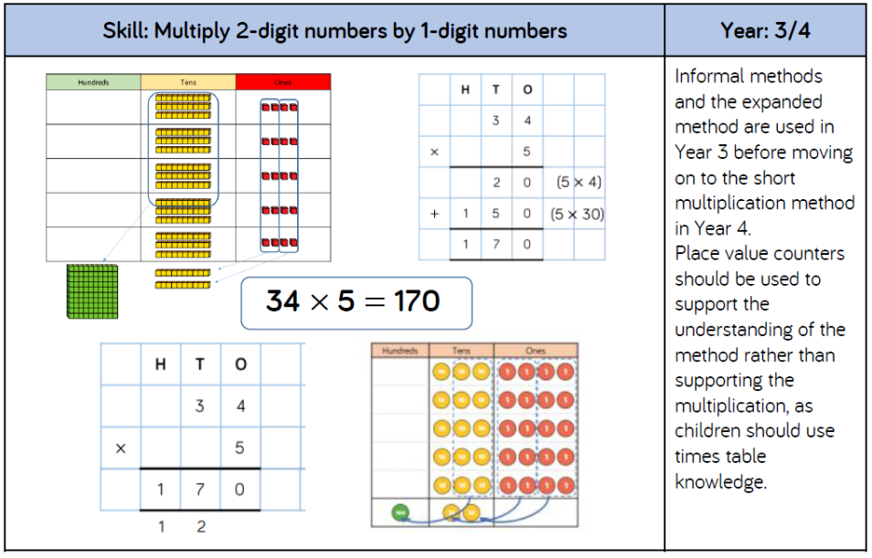
Multiplication and Division in Year 3

Slide 14
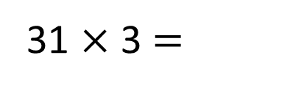
T | O
Have a think
31 $×$ 3 $=$
93
3
3
90
___ tens multiplied by ___ is equal to ___
___ one multiplied by ___ is equal to ___
___ multiplied by ___ is equal to ___
1
3
3
31
3
93

Slide 15
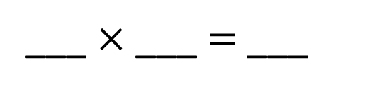
Have a think
T | O
22
4
88
___ $×$ ___ $=$ ___
What calculation is shown?

Slide 16

Have a think
What multiplication is shown by the counters?
Tens | Ones
32 $×$ 5
30
2
$×$5
$×$5
150 $+$
$=$ 160
10
32 $×$ 5 $=$ 160

Slide 17
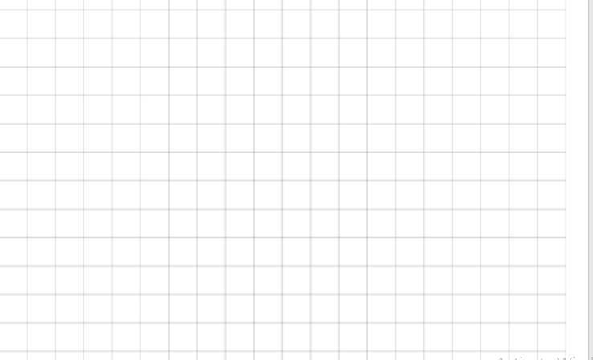
Column method multiplication is not taught in Year 3.

Slide 18
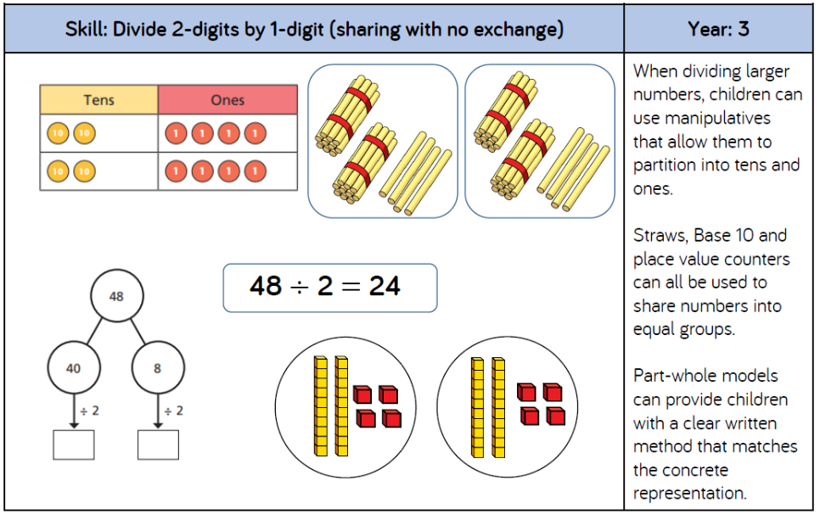
Multiplication and Division in Year 3

Slide 19
84 ÷ 4 =
21
Have a think
Tens | Ones

Slide 20
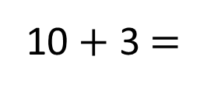
39 ÷ 3 =
13
96 ÷ 3 =
32
39
96
Have a think
30
9
90
6
÷ 3
÷ 3
÷ 3
÷ 3
10
3
30
2
10 + 3 $=$
13
30 + 2 $=$
32
39
9
96
3
___ partitioned into tens and ones is ___ tens and ____ ones.
6
9

Slide 21
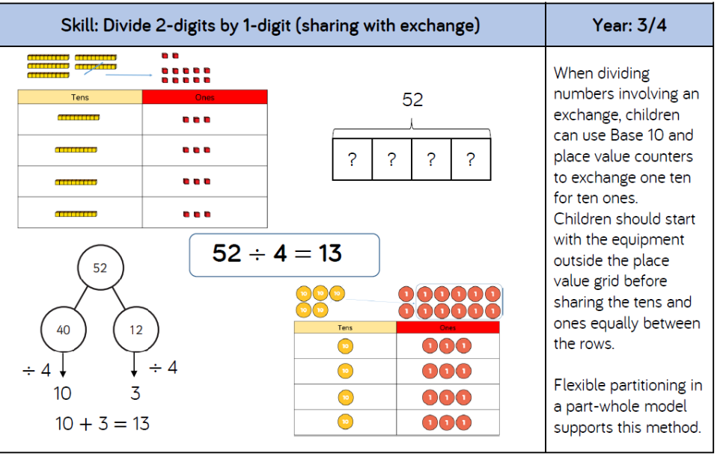
Multiplication and Division in Year 3

Slide 22

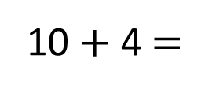
42 ÷ 3 =
14
But those groups aren’t equal!
42
42
___ can be flexibly partitioned into ___ and ___ as these numbers are both multiples of ___
30
12
3
Tens | Ones
40
30
12
2
÷ 3
÷ 3
10
4
10 + 4 $=$
14

Slide 23
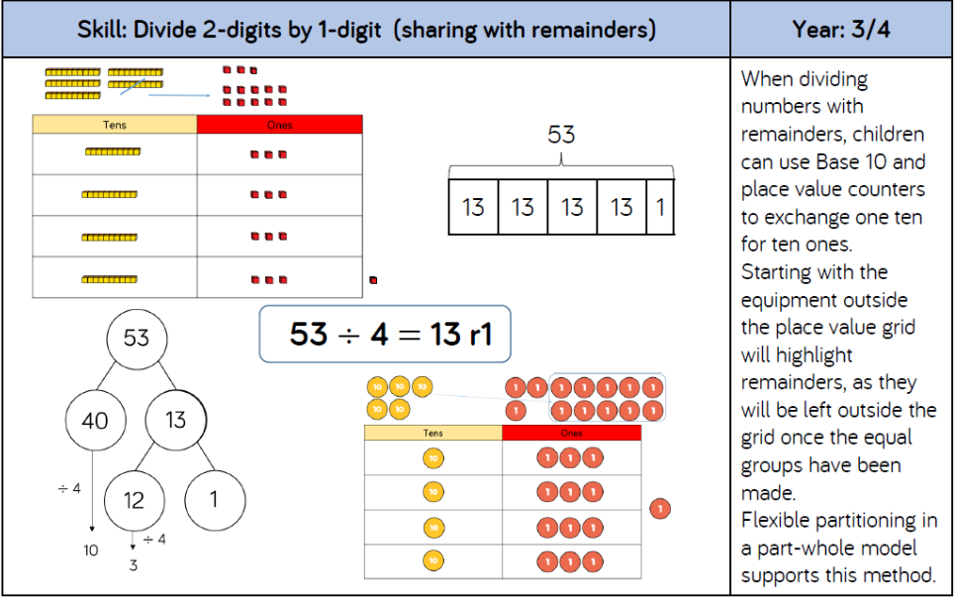
Multiplication and Division in Year 3

Slide 24
73 ÷ 3 =
24
remainder 1
Tens | Ones

