Slide 1

Welcome to St Alban’s
Year 6
Transition Meeting

Slide 2
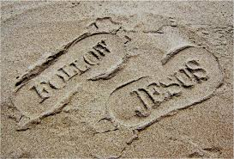
Following in the footsteps of Jesus we love, live and learn together.
Dear Lord,
At the beginning of this new school year we ask for your mercy. Bless the students, staff and parents of St Alban’s that together we may grow in faith, hope and love as we learn from you and each other how to follow your son Jesus.
Amen

Slide 3
The Year 6 Team
Mr Dowling - Class Teacher
Mrs Williams - Teaching Assistant
Contact:
year6@stalbanrc.bham.sch.uk

Slide 4
SEN and Inclusion:
Mrs Jones – SENCO
Mrs Doherty – Pastoral Lead
senco@stalbanrc.bham.sch.uk

Slide 5
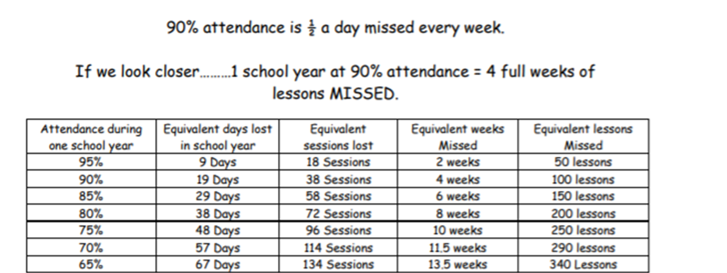
Attendance:

Slide 6
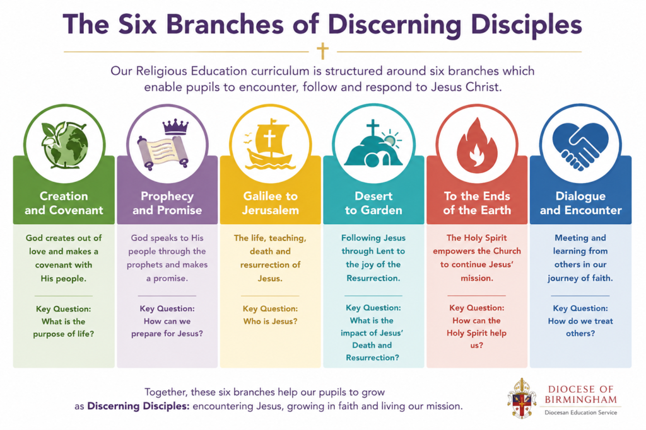

Religious Education:

Slide 7
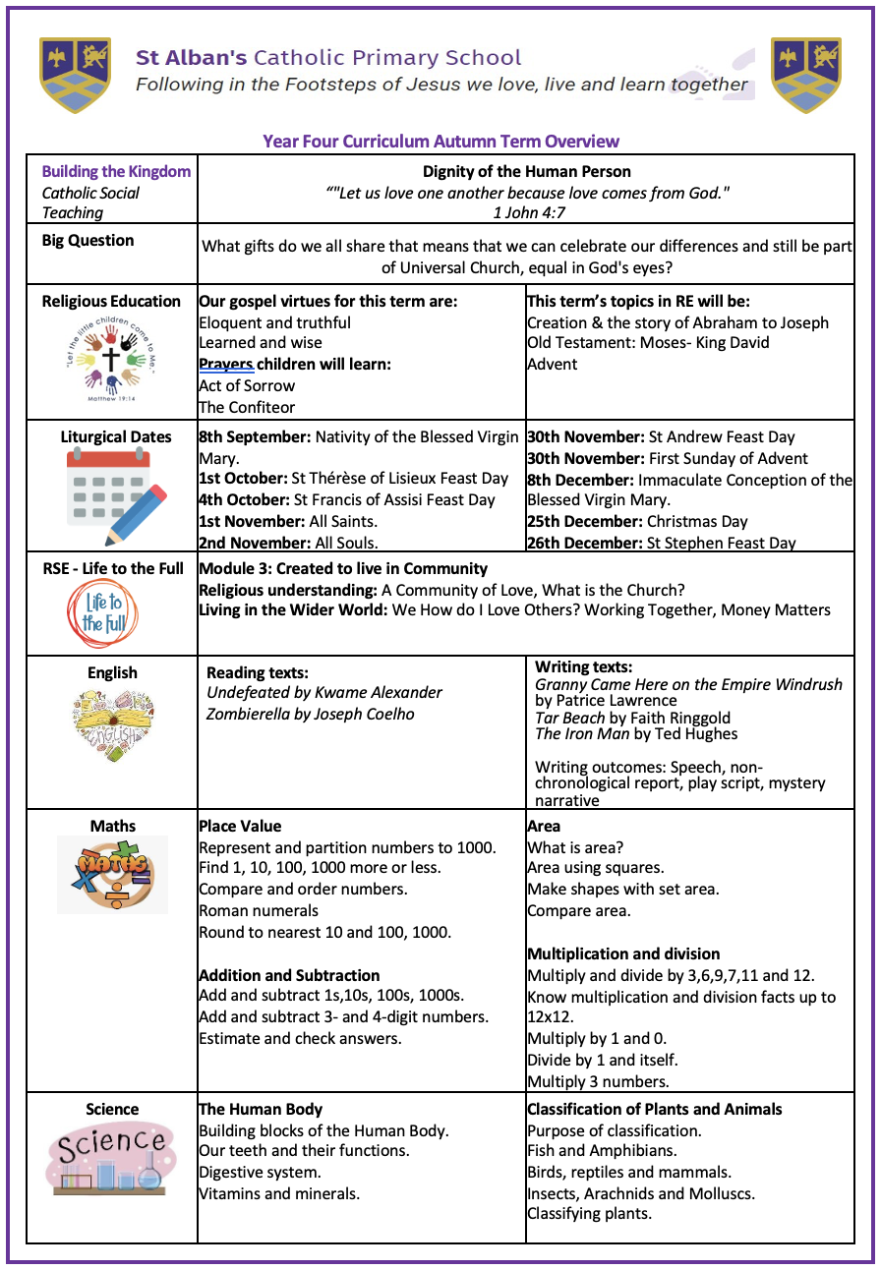
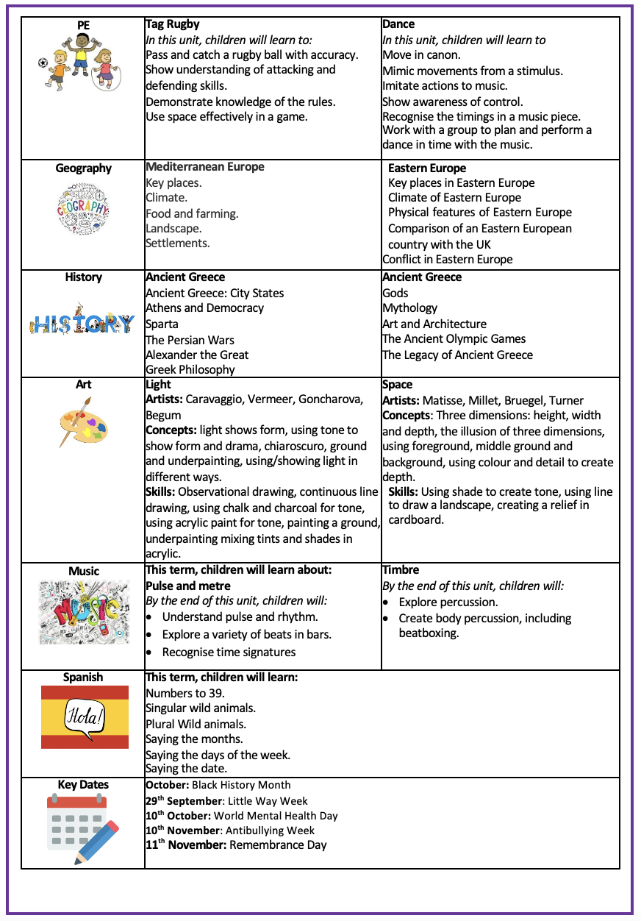
Year 6 Curriculum

Slide 8
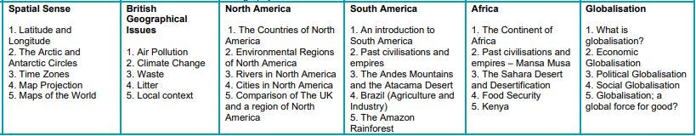
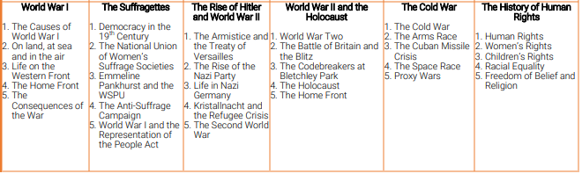
Year 6 Topics
Geography
History

Slide 9
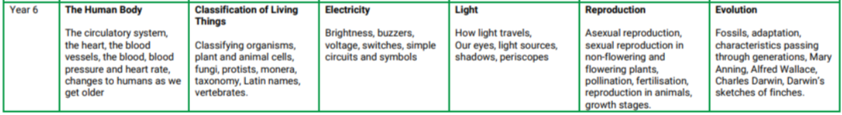
Year XX Topics
Science

Slide 10
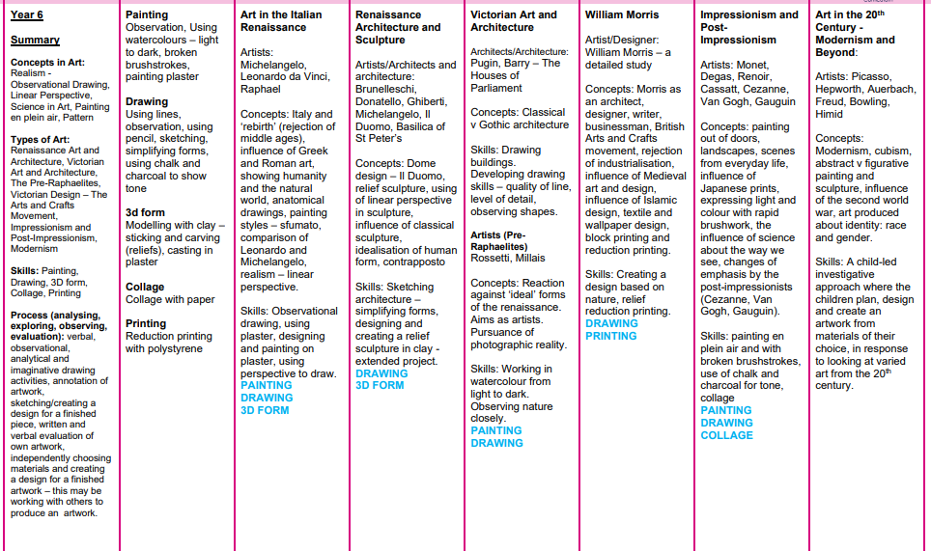
Art

Slide 11
Building the Kingdom Autumn Term: Family and Community
At St Albans, we belong to one human family.
Our Building the Kingdom theme—The Call to Family and Community—reminds us that we do not walk alone. We are called to look after our families, welcome the newcomer, and actively participate in our school and local communities to build a world where everyone thrives together.

Slide 12
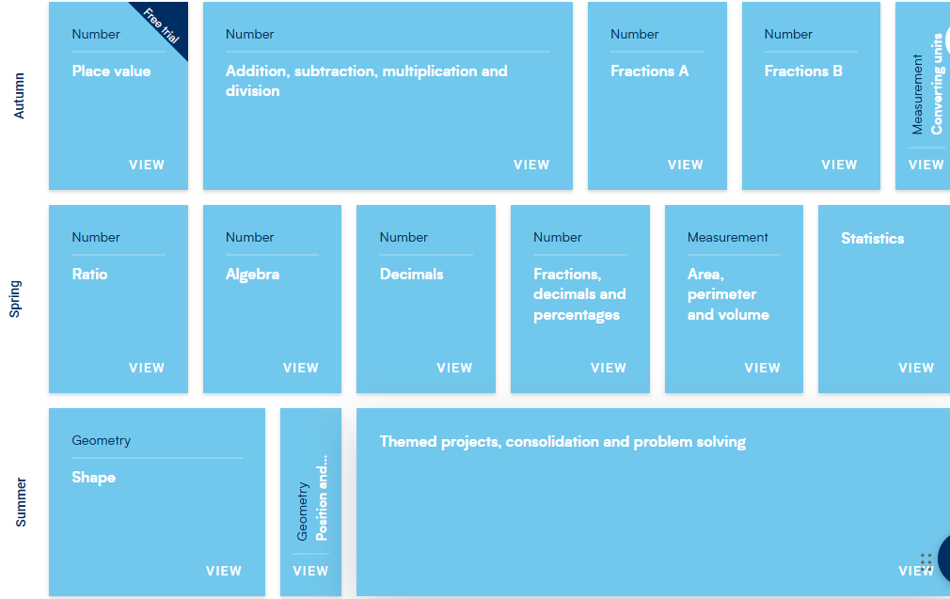
Maths

Slide 13
PE and Health:
Active day(s): Mondays and Thursdays
Bike and Scooter day: Friday

Slide 14


Life to the Full:
From September 2020, Relationship and Sex Education became statutory in all Secondary Schools and in all Primary Schools in England.
Relationship and Sex Education in Catholic Schools
It’s a programme in Relationships and Health Education based on the Department of Education guidance which became statutory during the academic year 2020/21. This programme is rooted in a Christian understanding of the human person, based on “A Model Catholic RSE Curriculum’’ provided by the Catholic Education Service.

Slide 15
Parent Portal:
https://www.tentenresources.co.uk/parent-portal/
To access the Parent Portal please follow the link above, you will need the following login credentials for our school:
School Username: st-alban-b14
School Password: cathedral-city

Slide 16

My Happy Mind:
My Happy Mind is an NHS-backed, science-based mental health and wellbeing program used in schools and homes to help children build resilience, confidence, and self-esteem.
Lessons will take place weekly in school and information will be sent out to parents about how you can access the portal at home.

Slide 17
Important dates:
17.9.26 – Year 6 Trip to Columban Fathers
23.9.26 – Father John’s Sacramental Programme meeting from 3.15-3.25 Parents invited
26.9.26 – Sacramental Mass of Commitment for year 6
22.10.26 – Parent consultations
2.11.26-4.11.26 – Residential Trip
4.2.26 – Sacrament of Confirmation at St Dunstan’s at 6.30

Slide 18
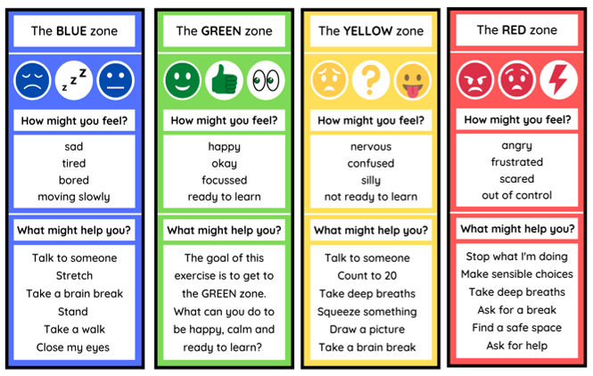
Rewards and Regulation:
Shining Star Certificate for academic achievements
Champions of Christ certificate for demonstrating the principles of Catholic Social teaching
Gospel Virtues
House Points
Whole class reward
My Happy Mind
Zones of Regulation

Slide 19
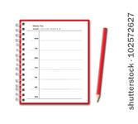
Planners:
Children should record the name of their book and the page numbers they have read each night, along with any unfamiliar/challenging words
Parents, please check and sign planners
Planners will be checked/signed weekly in school (each Friday)

Slide 20
Homework: (Delete as appropriate)
Daily reading – 10 minutes a day (Signed by parents)
Maths – Times tables practice weekly
Spelling: Children will stick or write their new spellings into their spelling books each Friday. They will be tested on their spellings the following Wednesday.
CGP Maths book weekly – to be marked in class.

Slide 21

Any questions?
If you have questions at any point throughout the year please speak to me after children have been dismissed or contact me via the Year XX email address: year6@stalbanrc.bham.sch.uk

